Slide 1

LENDING CLUB CASE STUDY

Slide 2
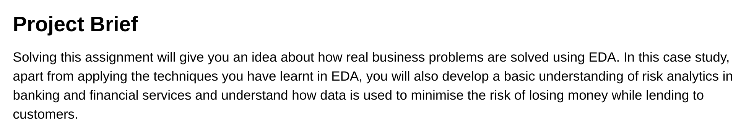

Slide 3
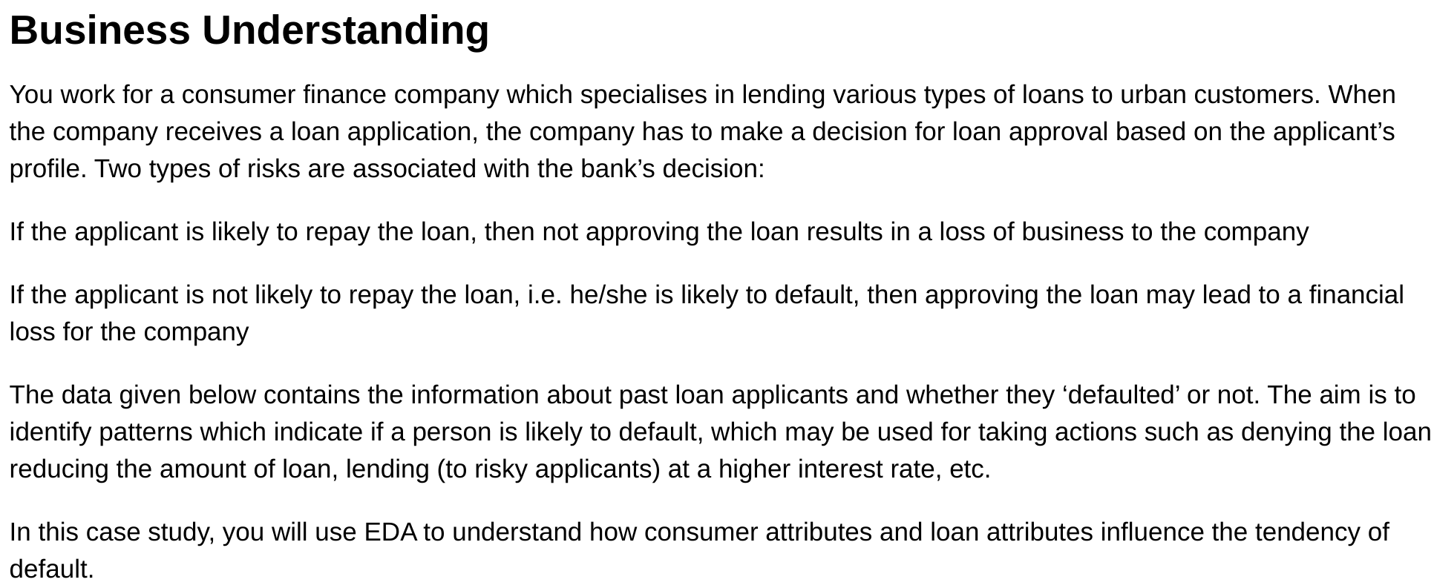

Slide 4
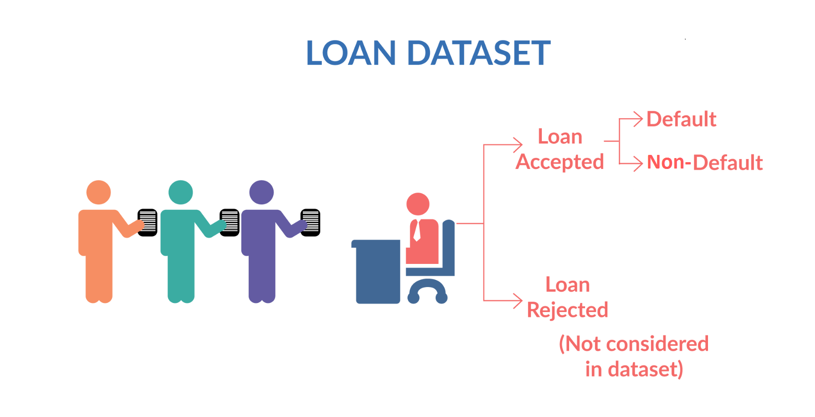
Figure 1. Loan Data Set
<number>

Slide 5
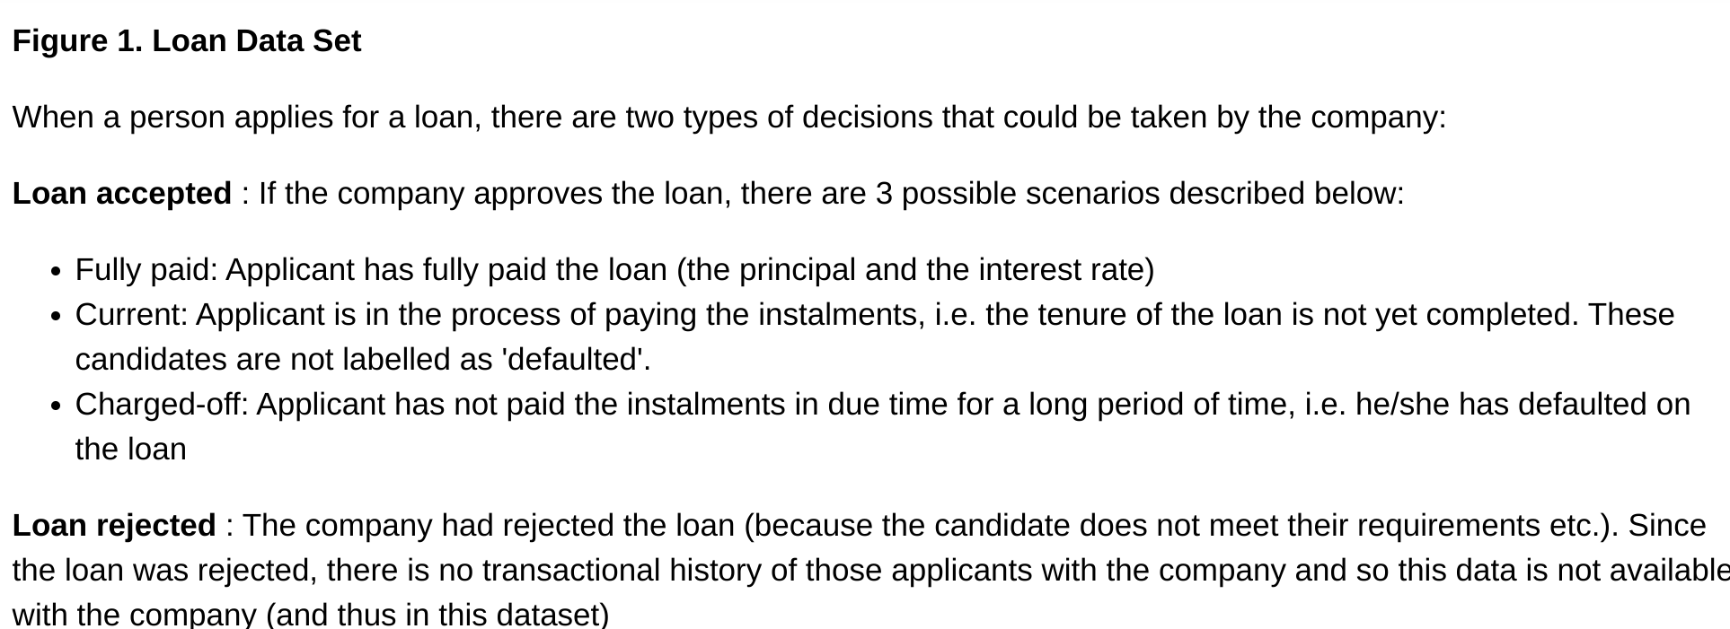

Slide 6
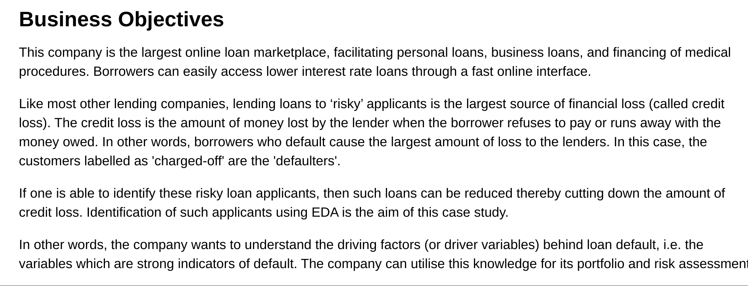

Slide 7
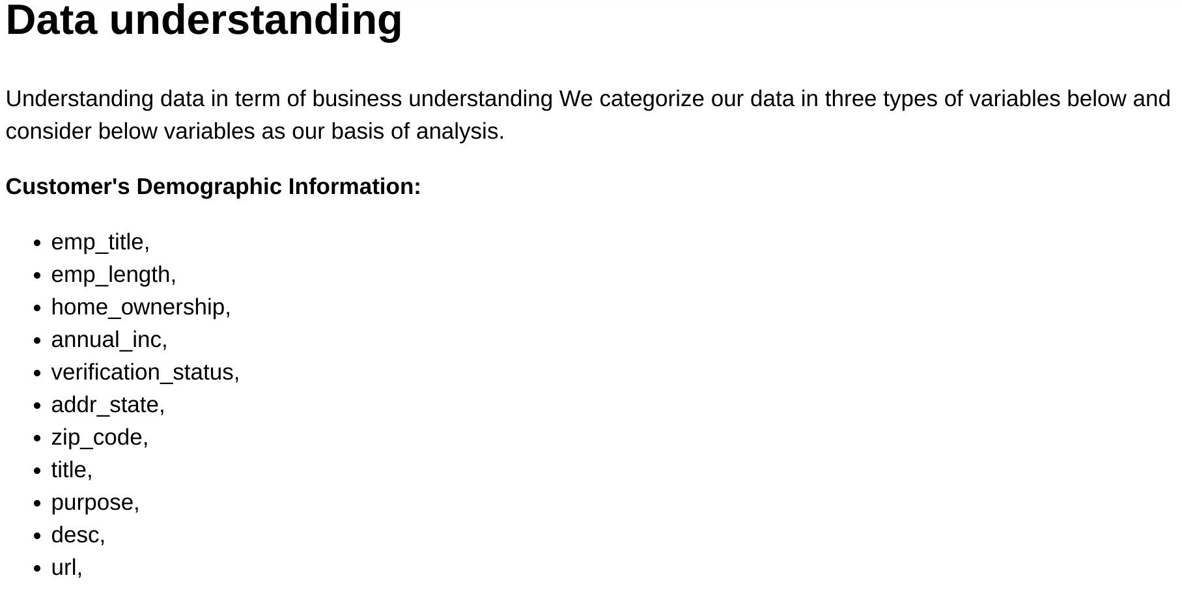

Slide 8
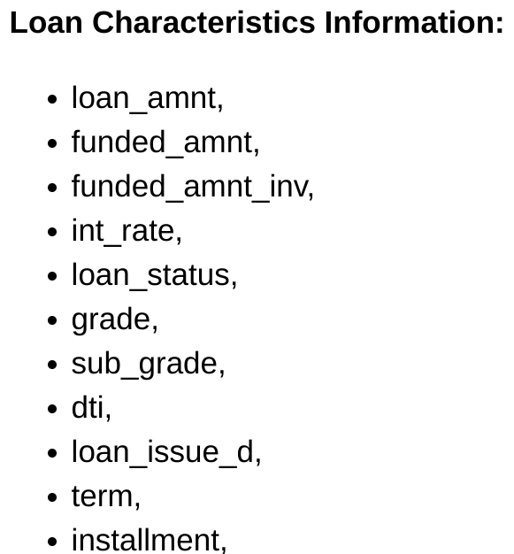

Slide 9
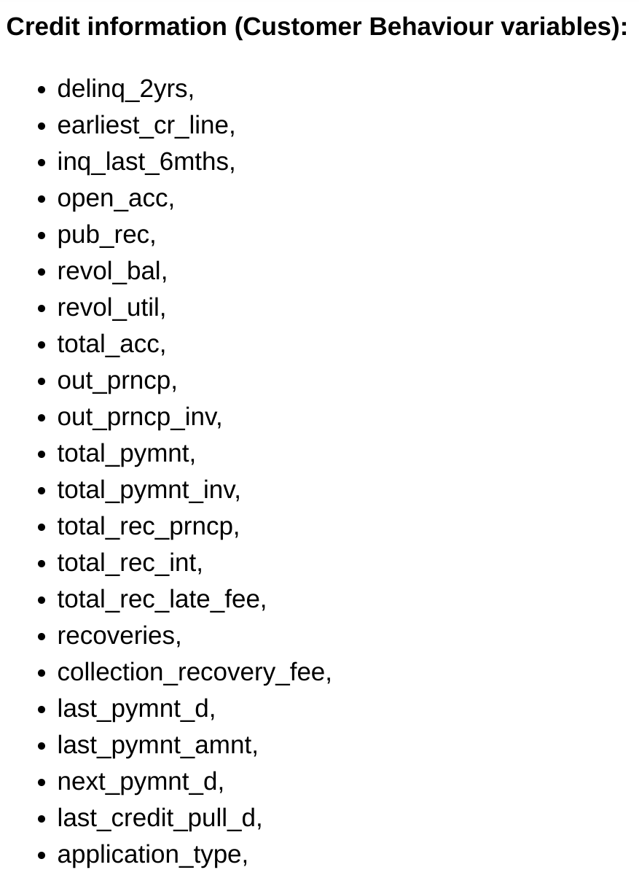

Slide 10
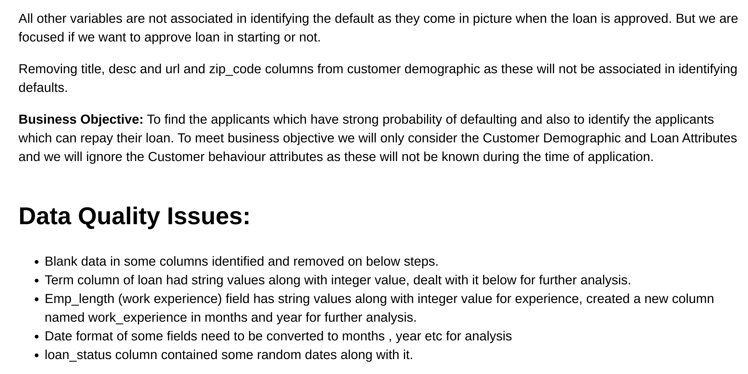

Slide 11

Univariate Analysis

Slide 12
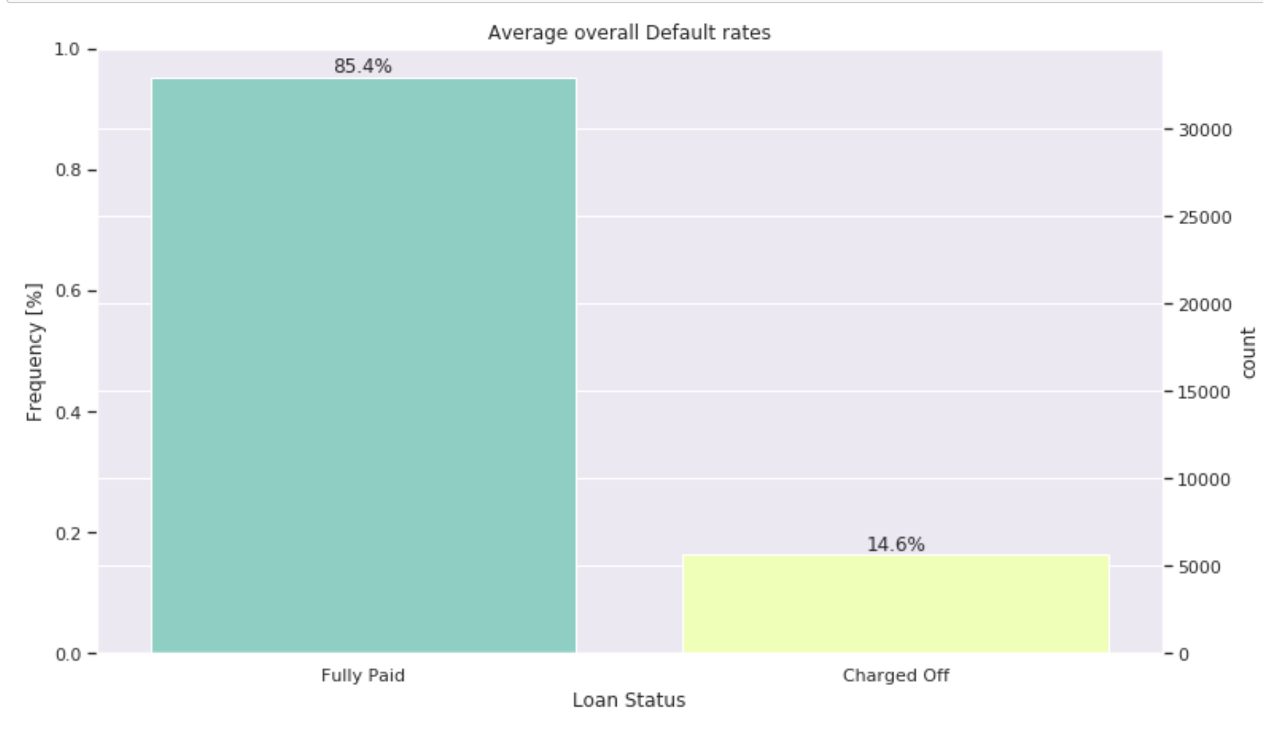
1) Loan Status Column Analysis

Slide 13
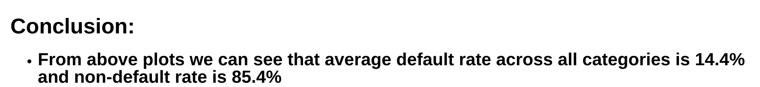

Slide 14
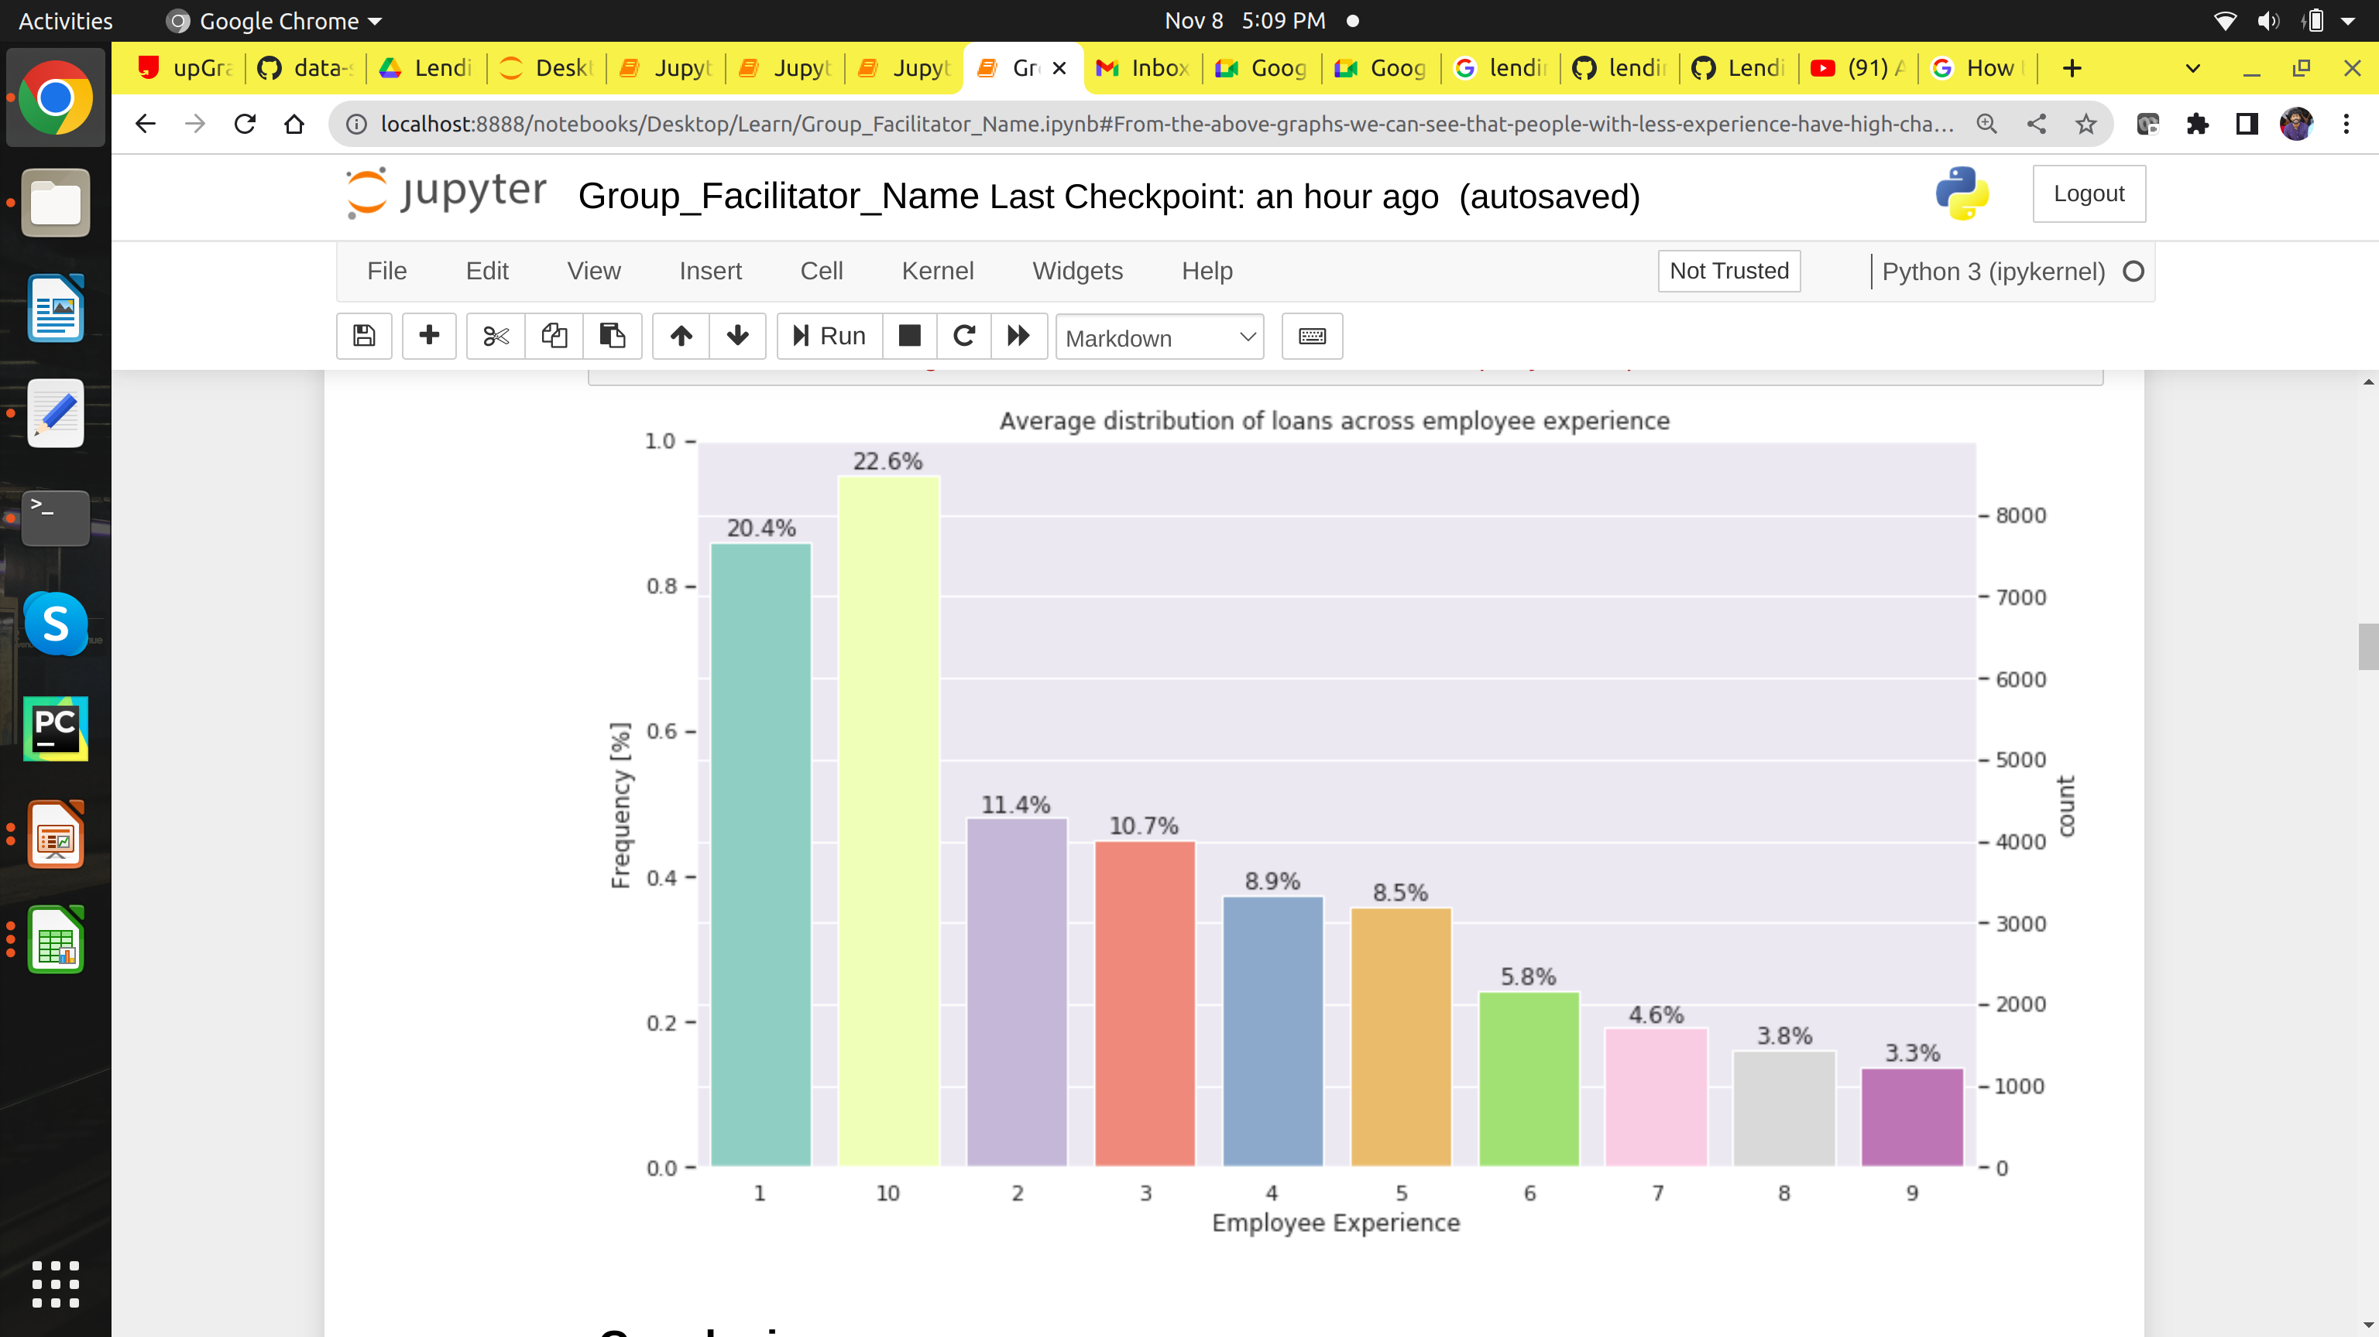
2) Employee Work Experience Analysis

Slide 15
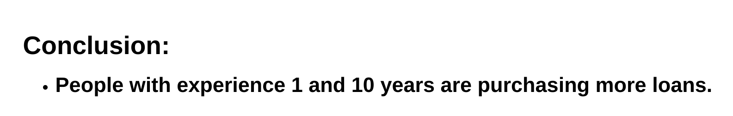

Slide 16
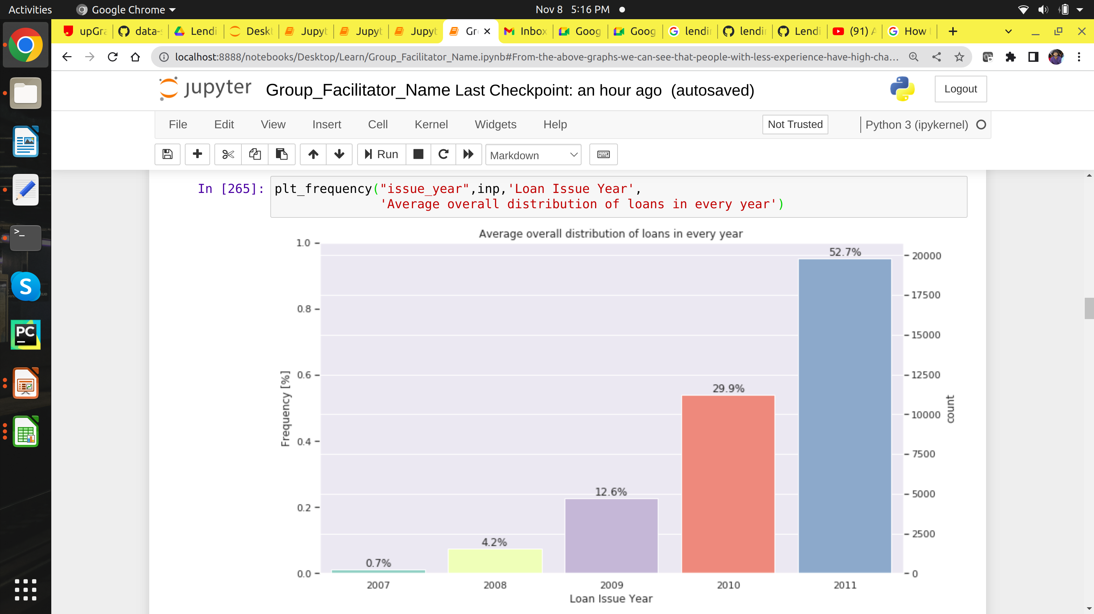
3) Loan Year Analysis

Slide 17
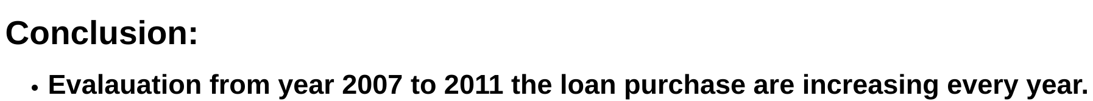

Slide 18
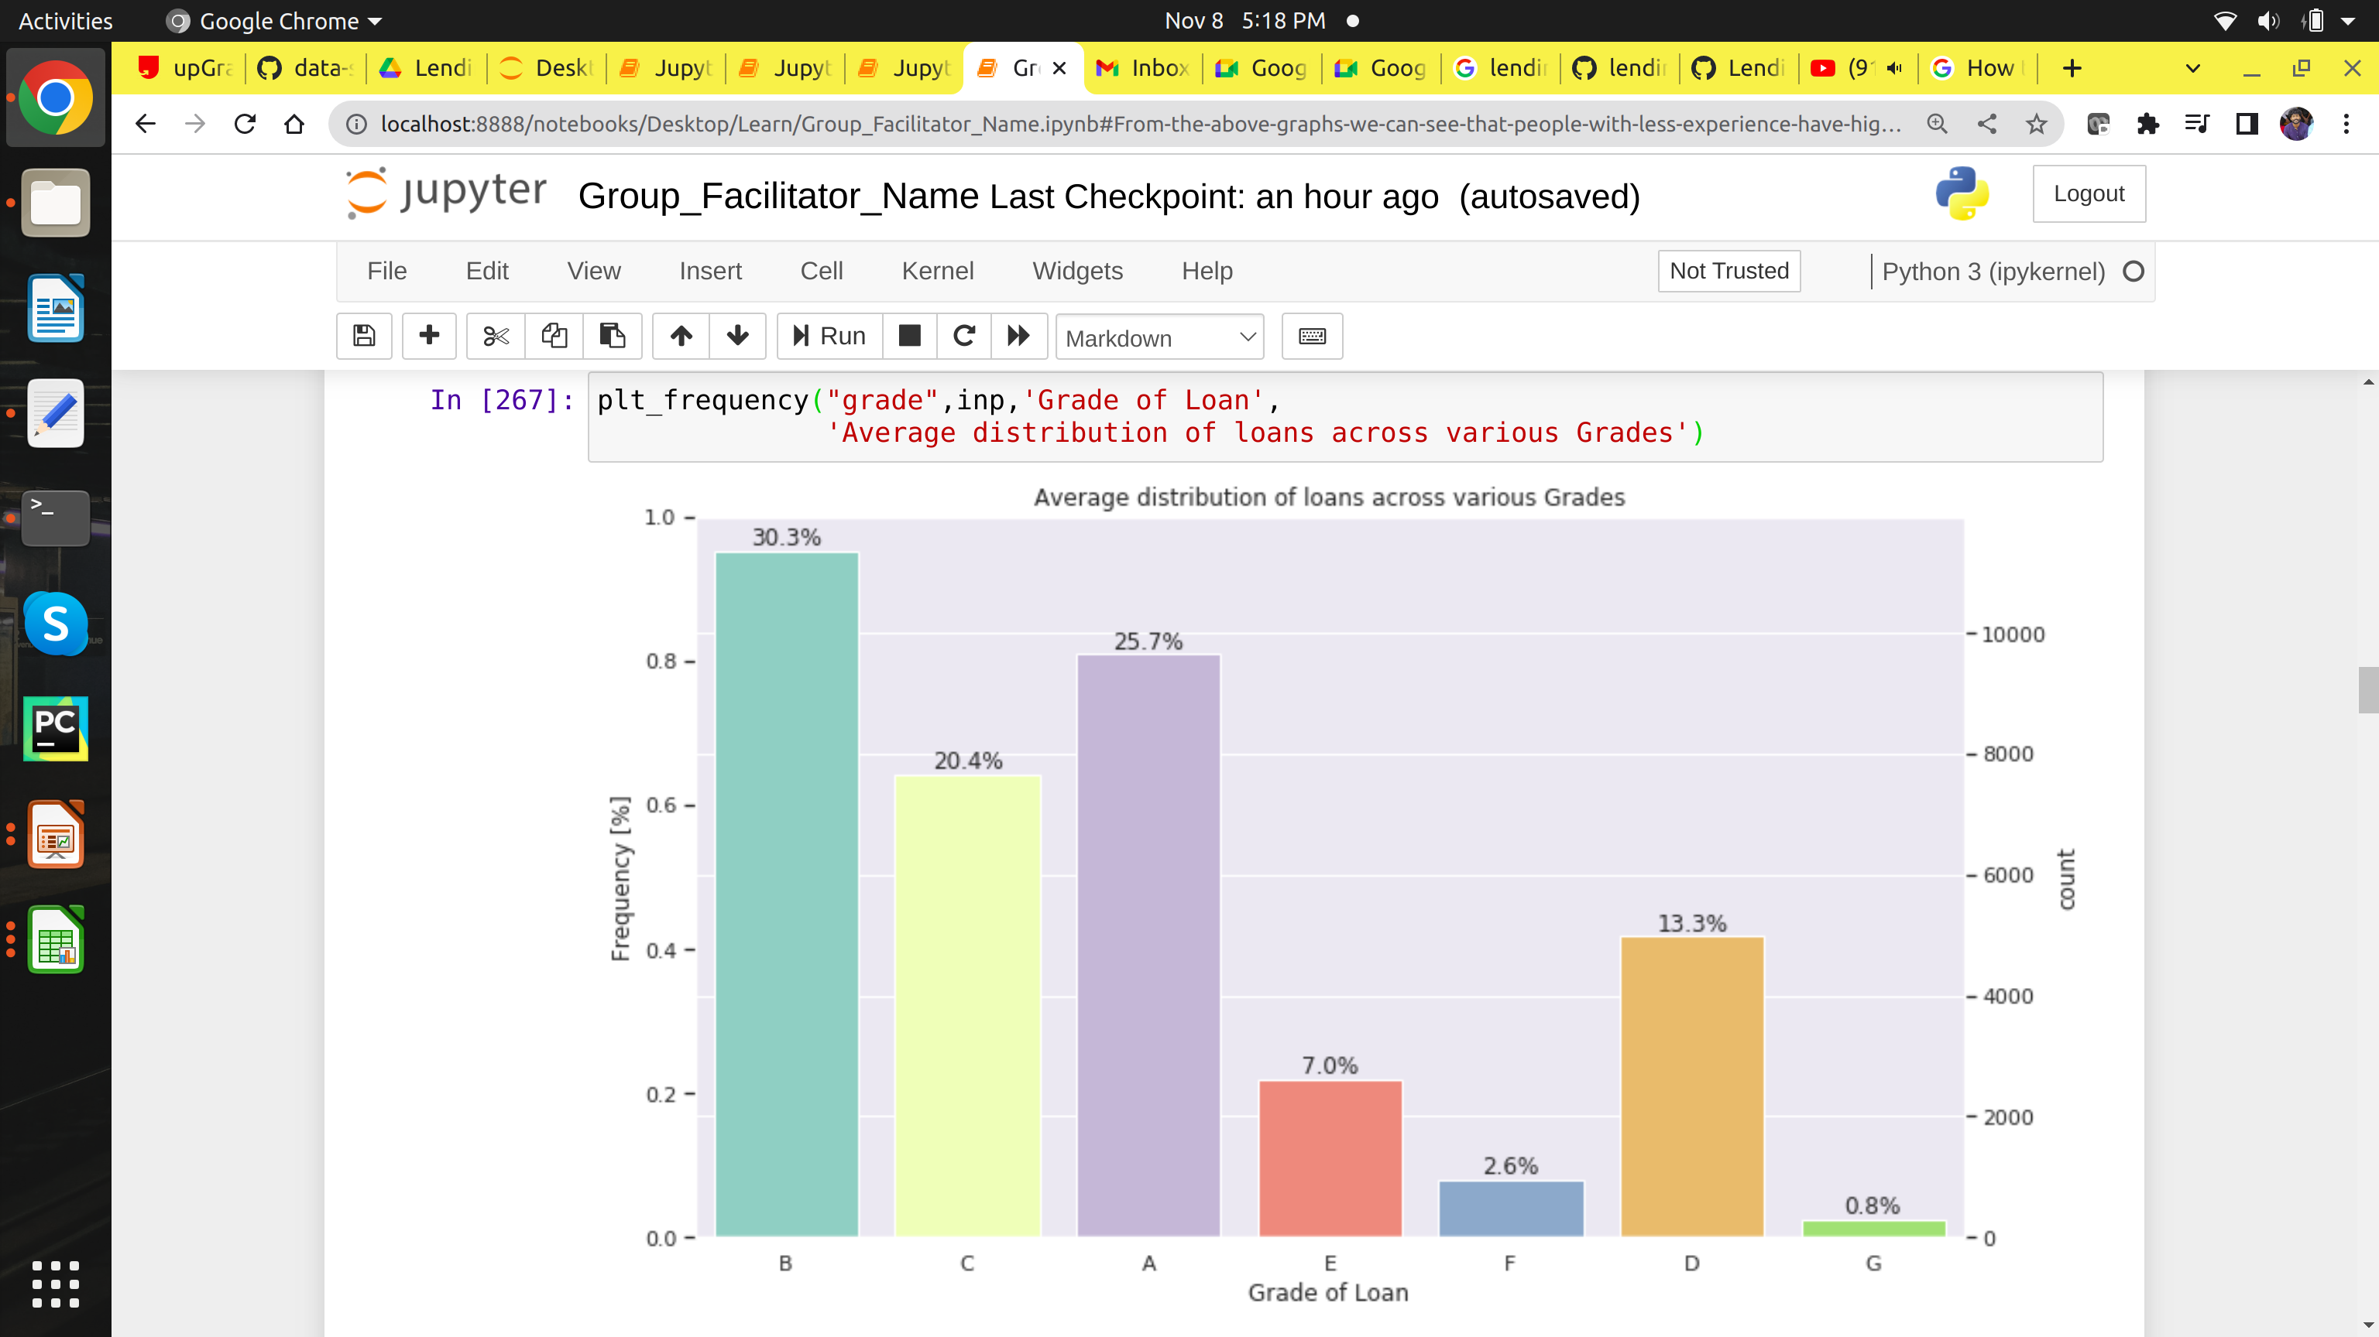
4) Grade Column Analysis

Slide 19
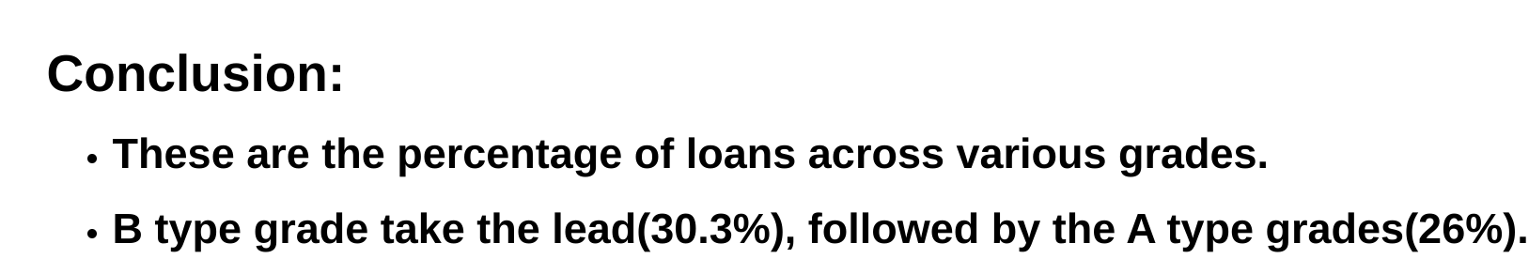

Slide 20
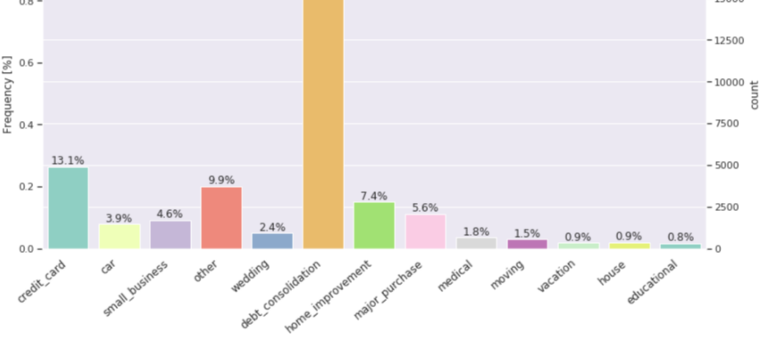
5) Purpose Column Analysis

Slide 21
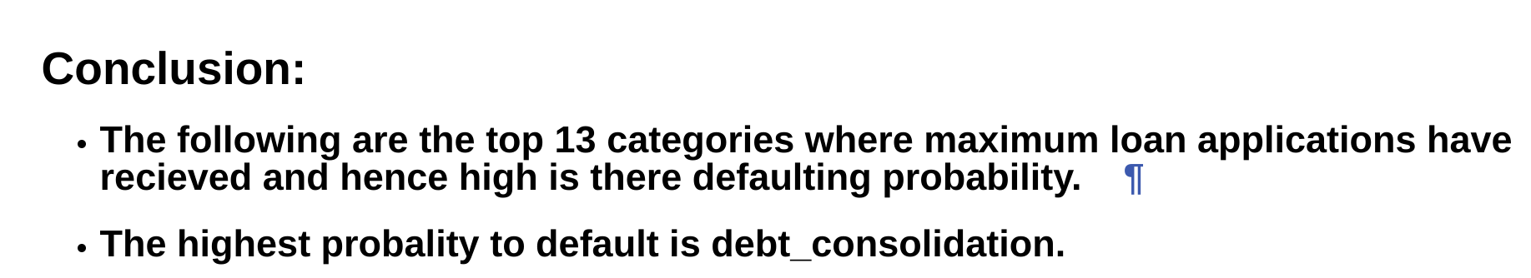

Slide 22
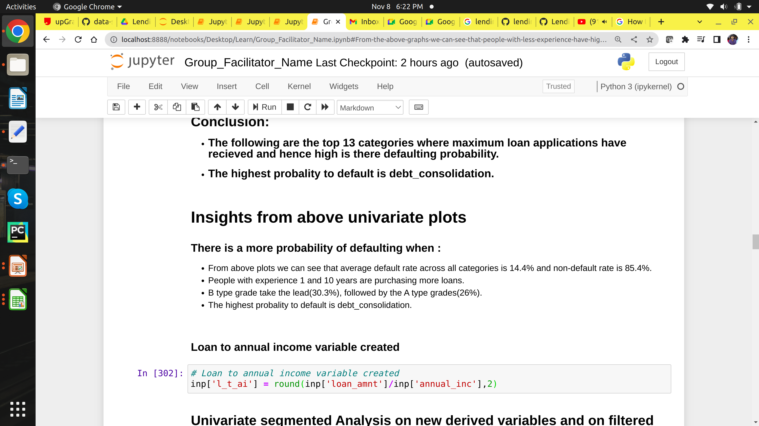

Slide 23

Univariate segmented Analysis on new derived variables

Slide 24
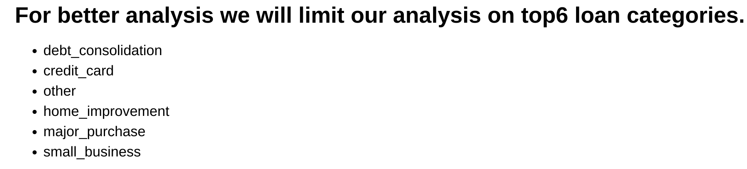

Slide 25
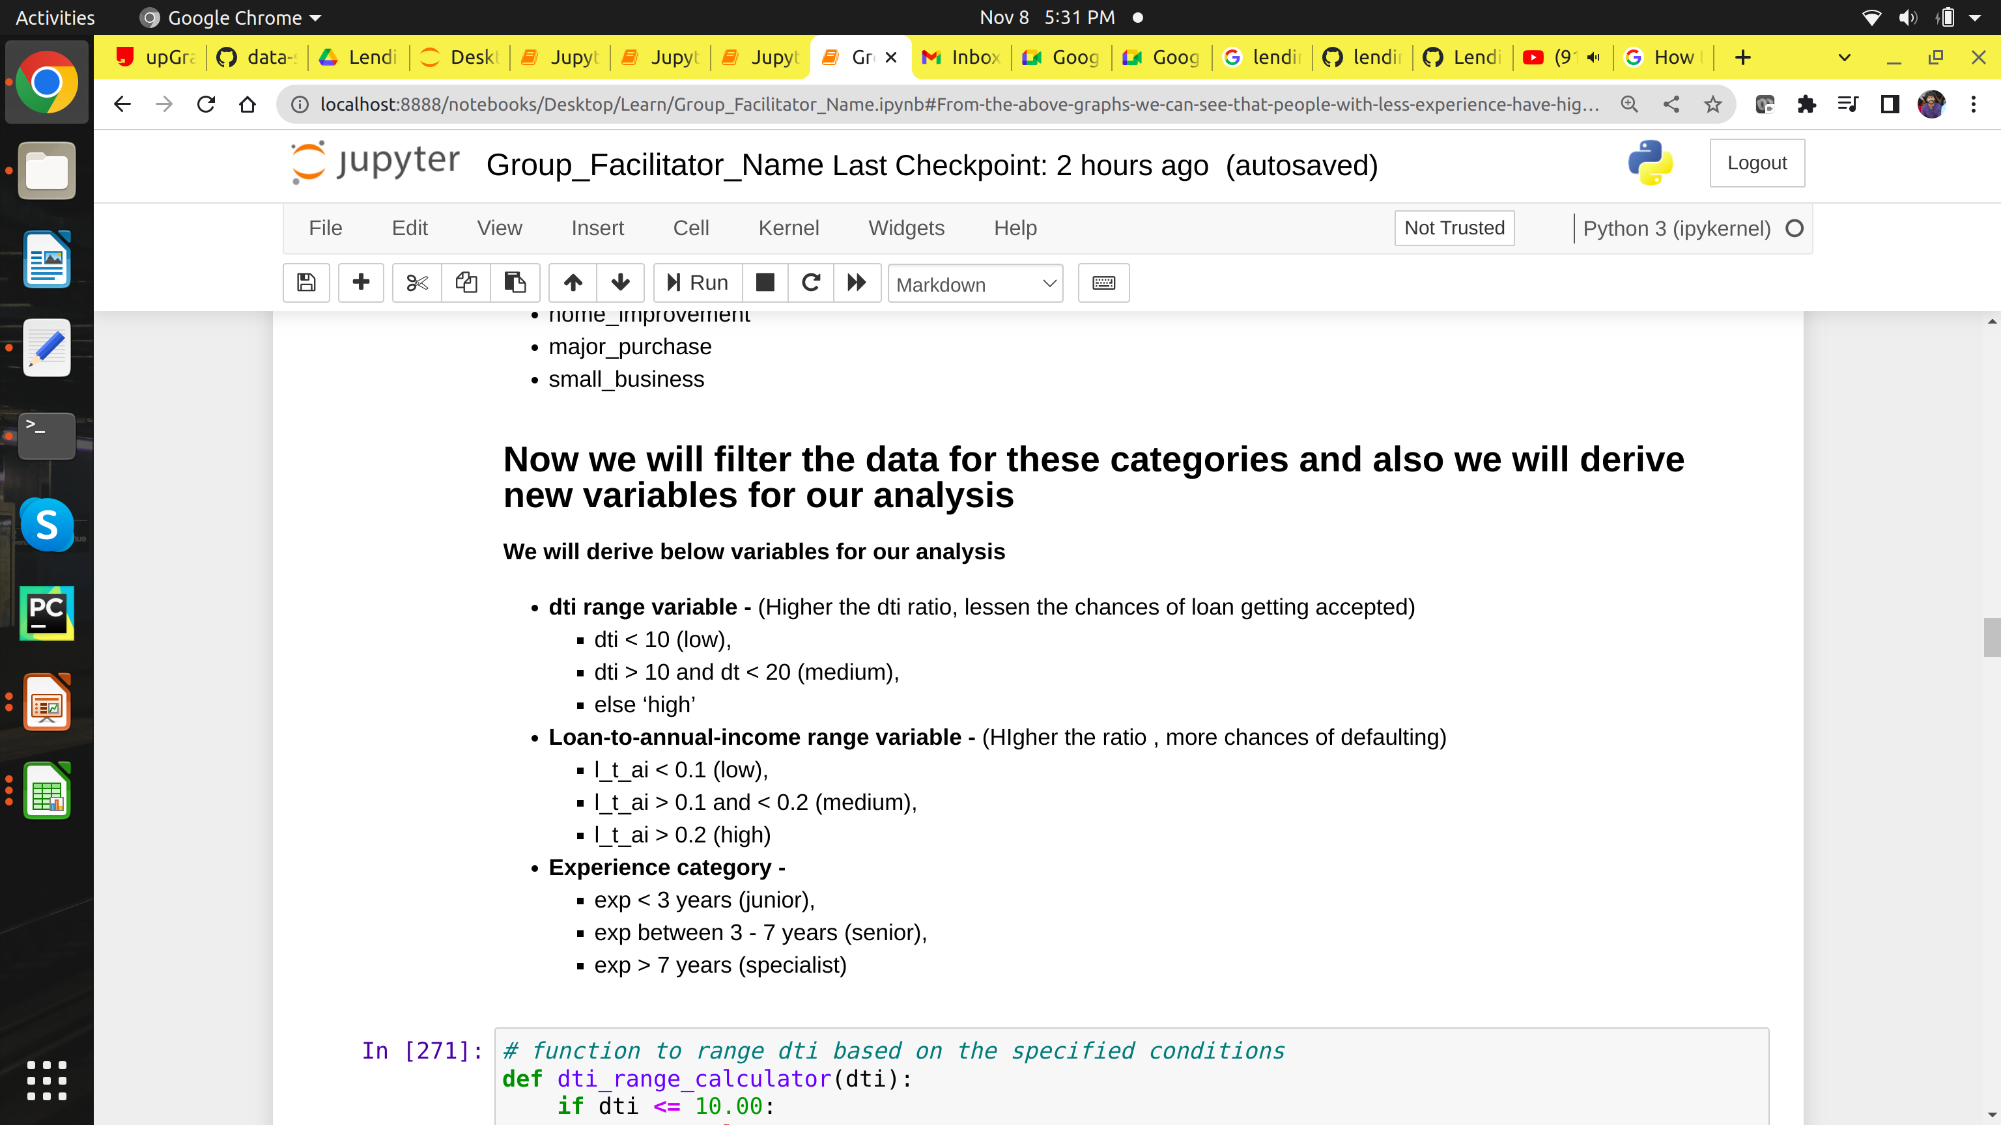

Slide 26
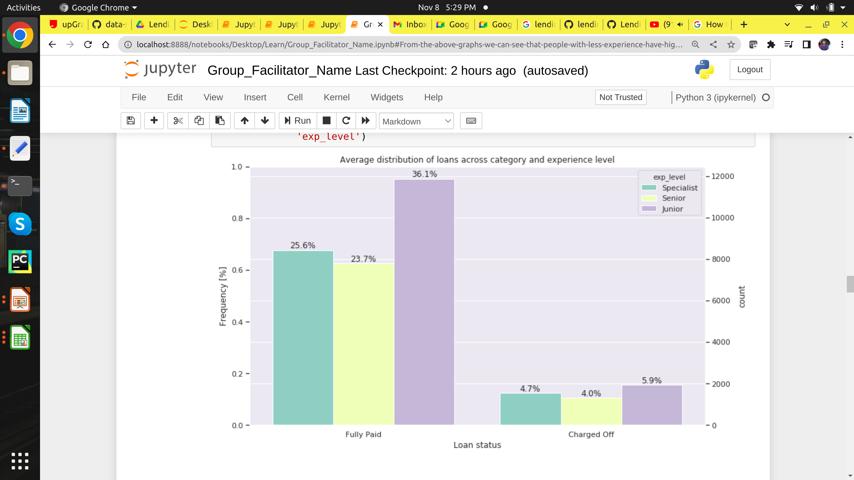
1.Experience level based on loan category

Slide 27
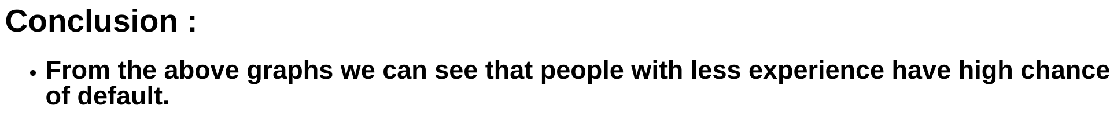

Slide 28
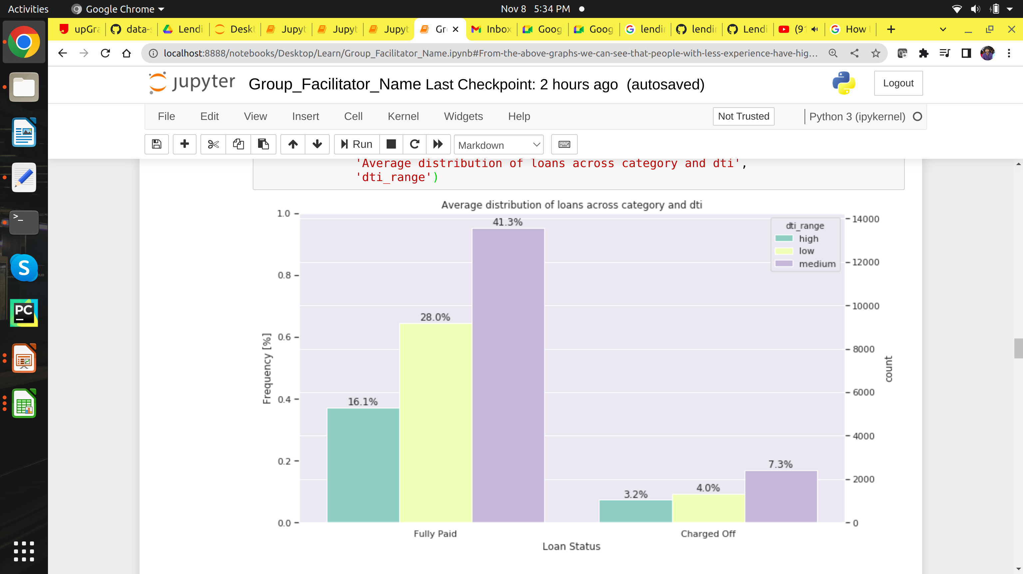
2. Debt-income-range based on loan category

Slide 29
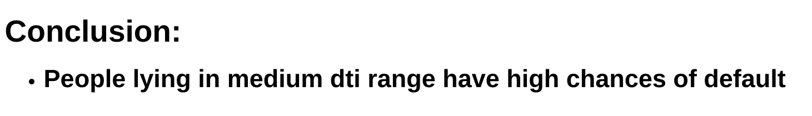

Slide 30
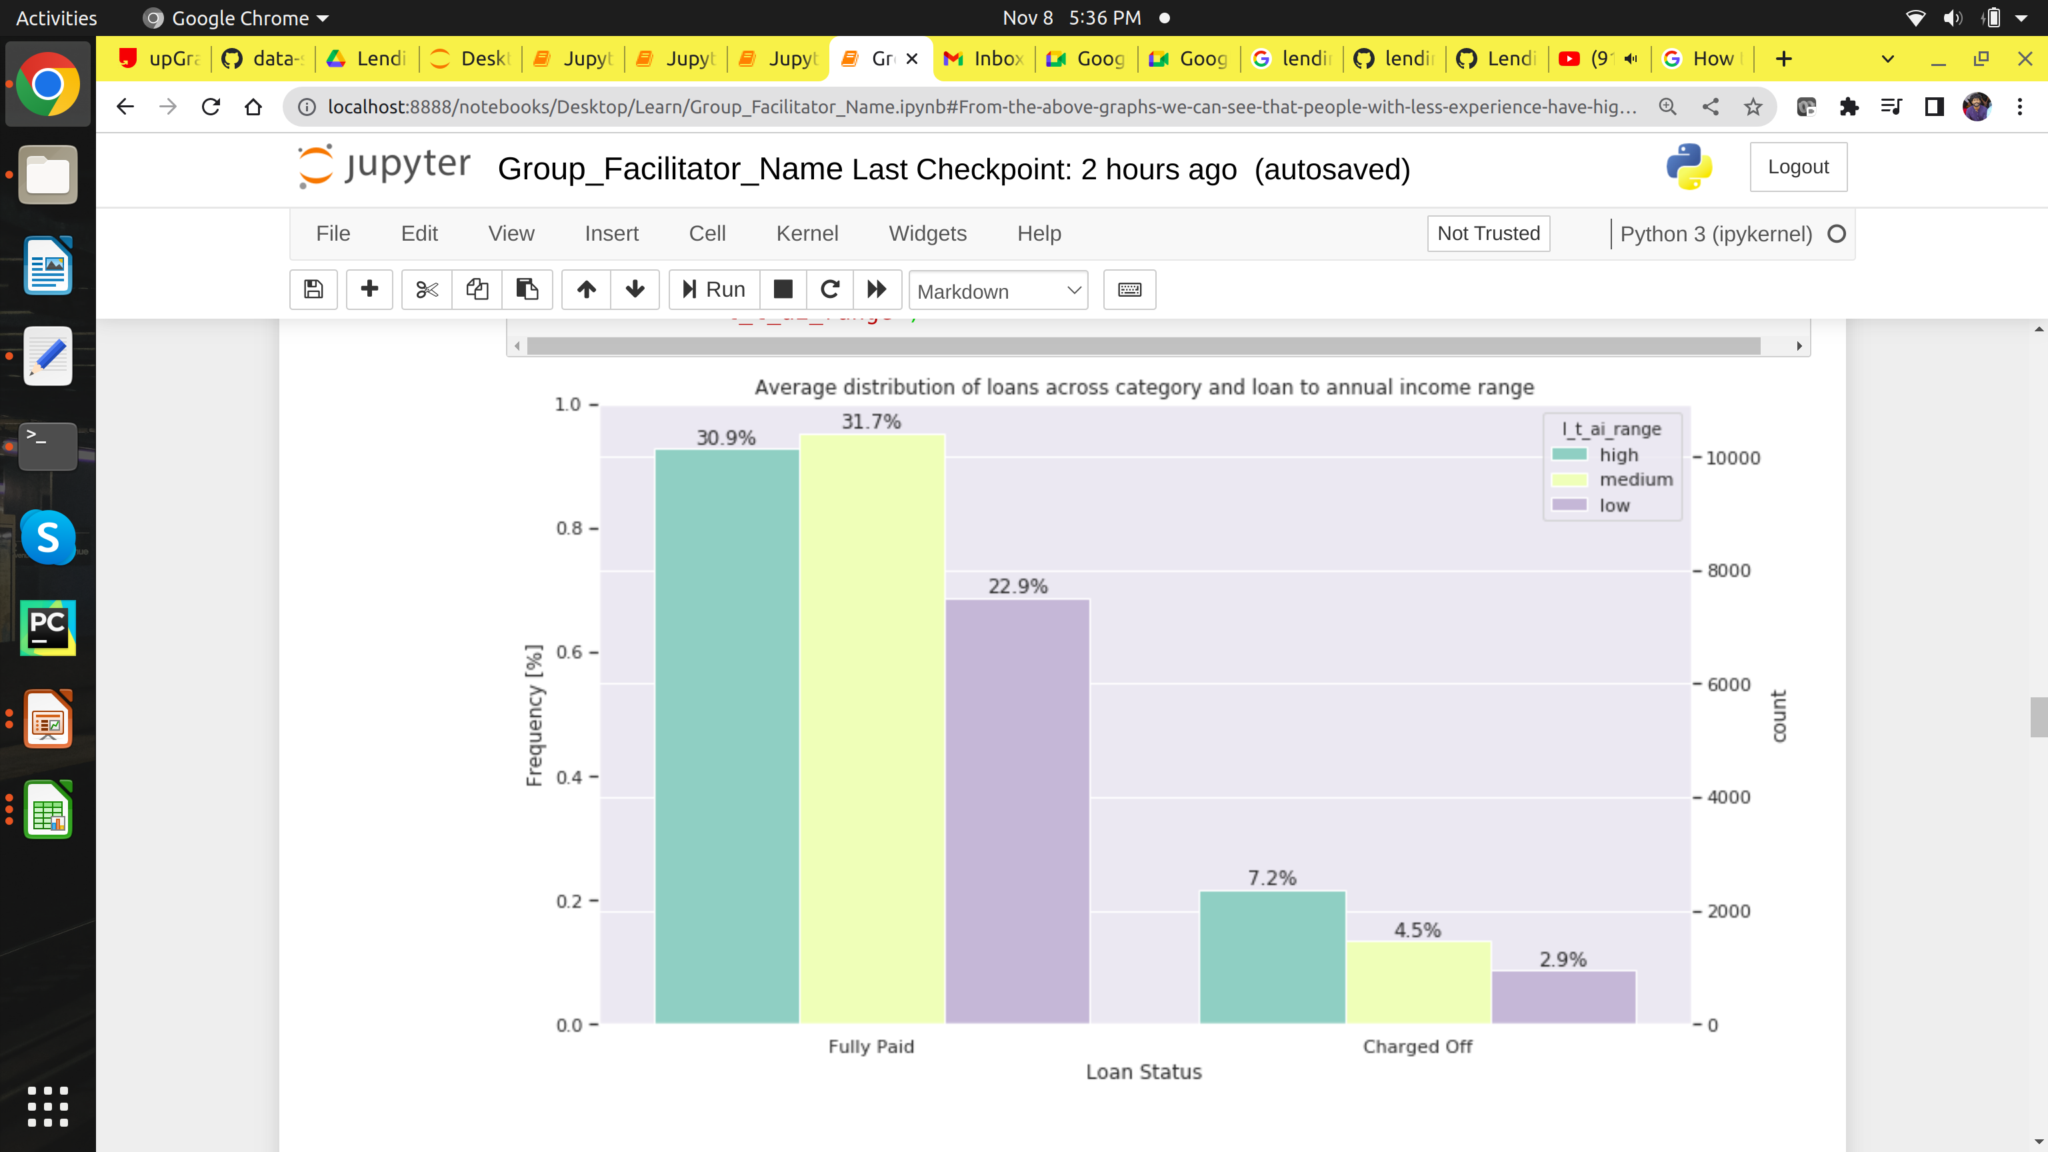
3.Loan-to-annual-icome-range based on loan category

Slide 31
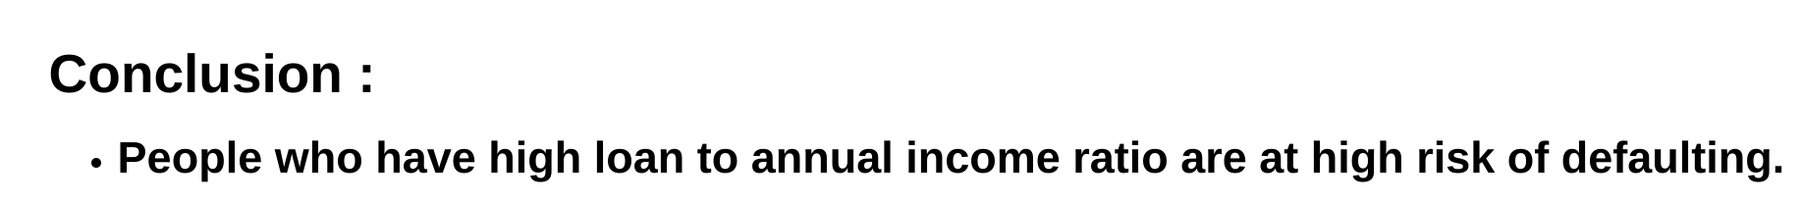

Slide 32
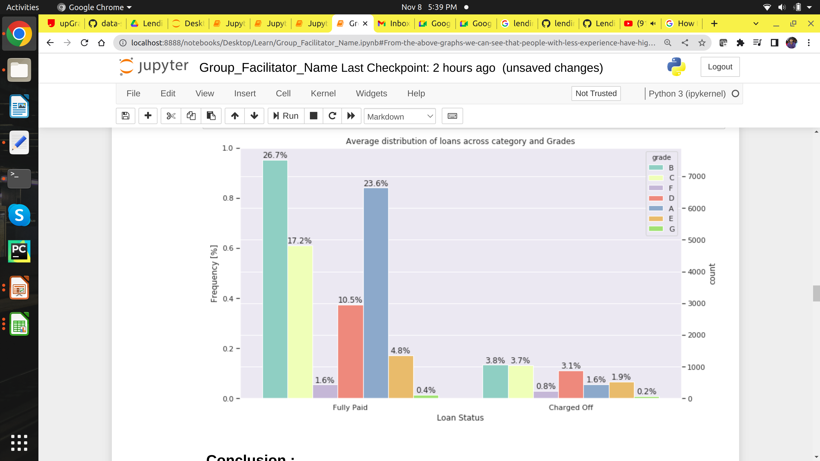
4.Grade based on loan category

Slide 33
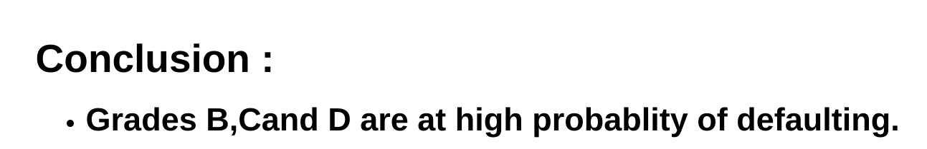

Slide 34
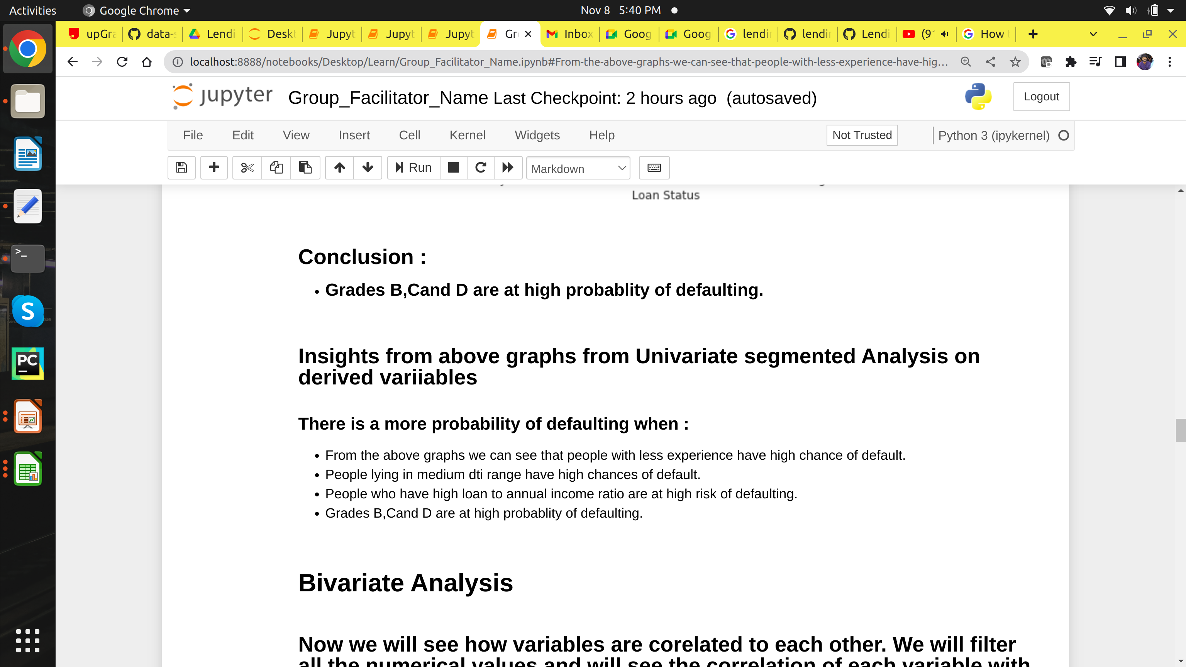

Slide 35

Bivariate Analysis

Slide 36
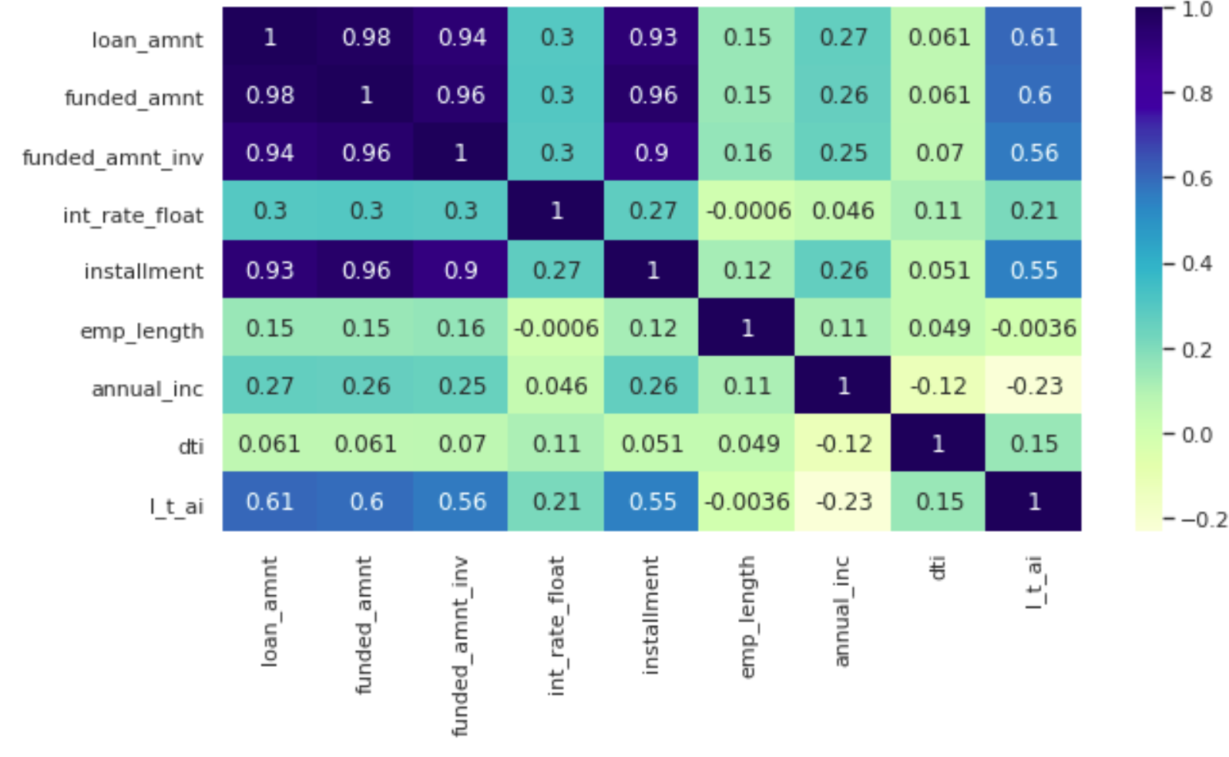
Correlation Plot of numerical variables

Slide 37
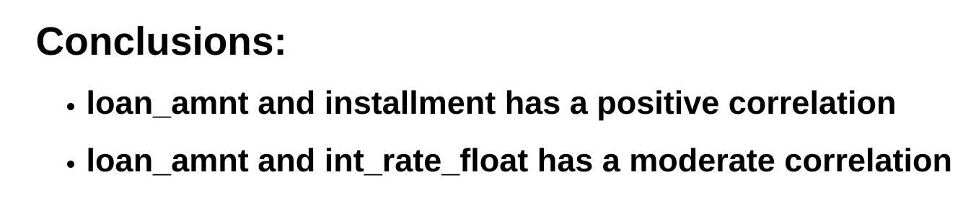

Slide 38

Analysing loan amount with other columns for more insights

Slide 39
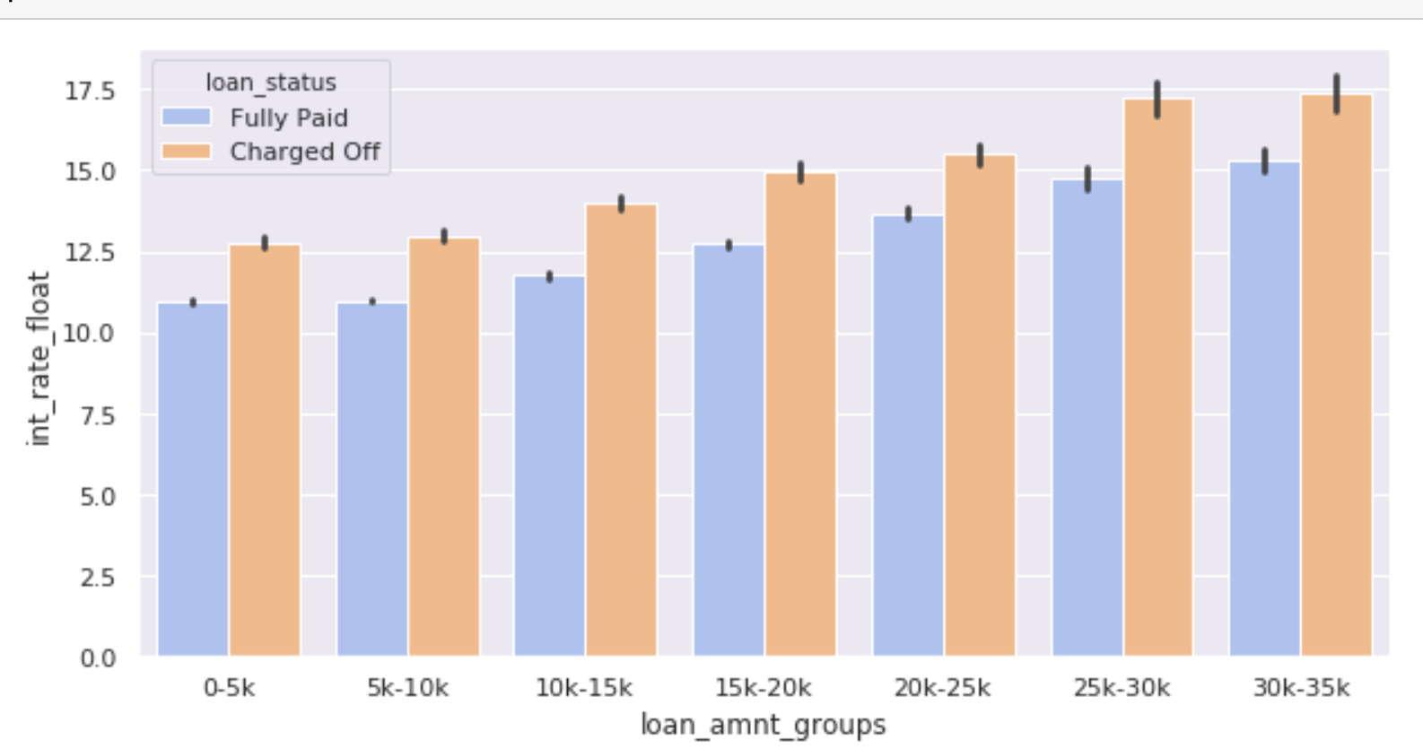
1.Loan Amount vs Interest Rate
loan_amnt_groups are created from loan amnt by grouping them based on the list ['0-5k','5k-10k','10k-15k','15k-20k','20k-25k','25k-30k','30k-35k']

Slide 40
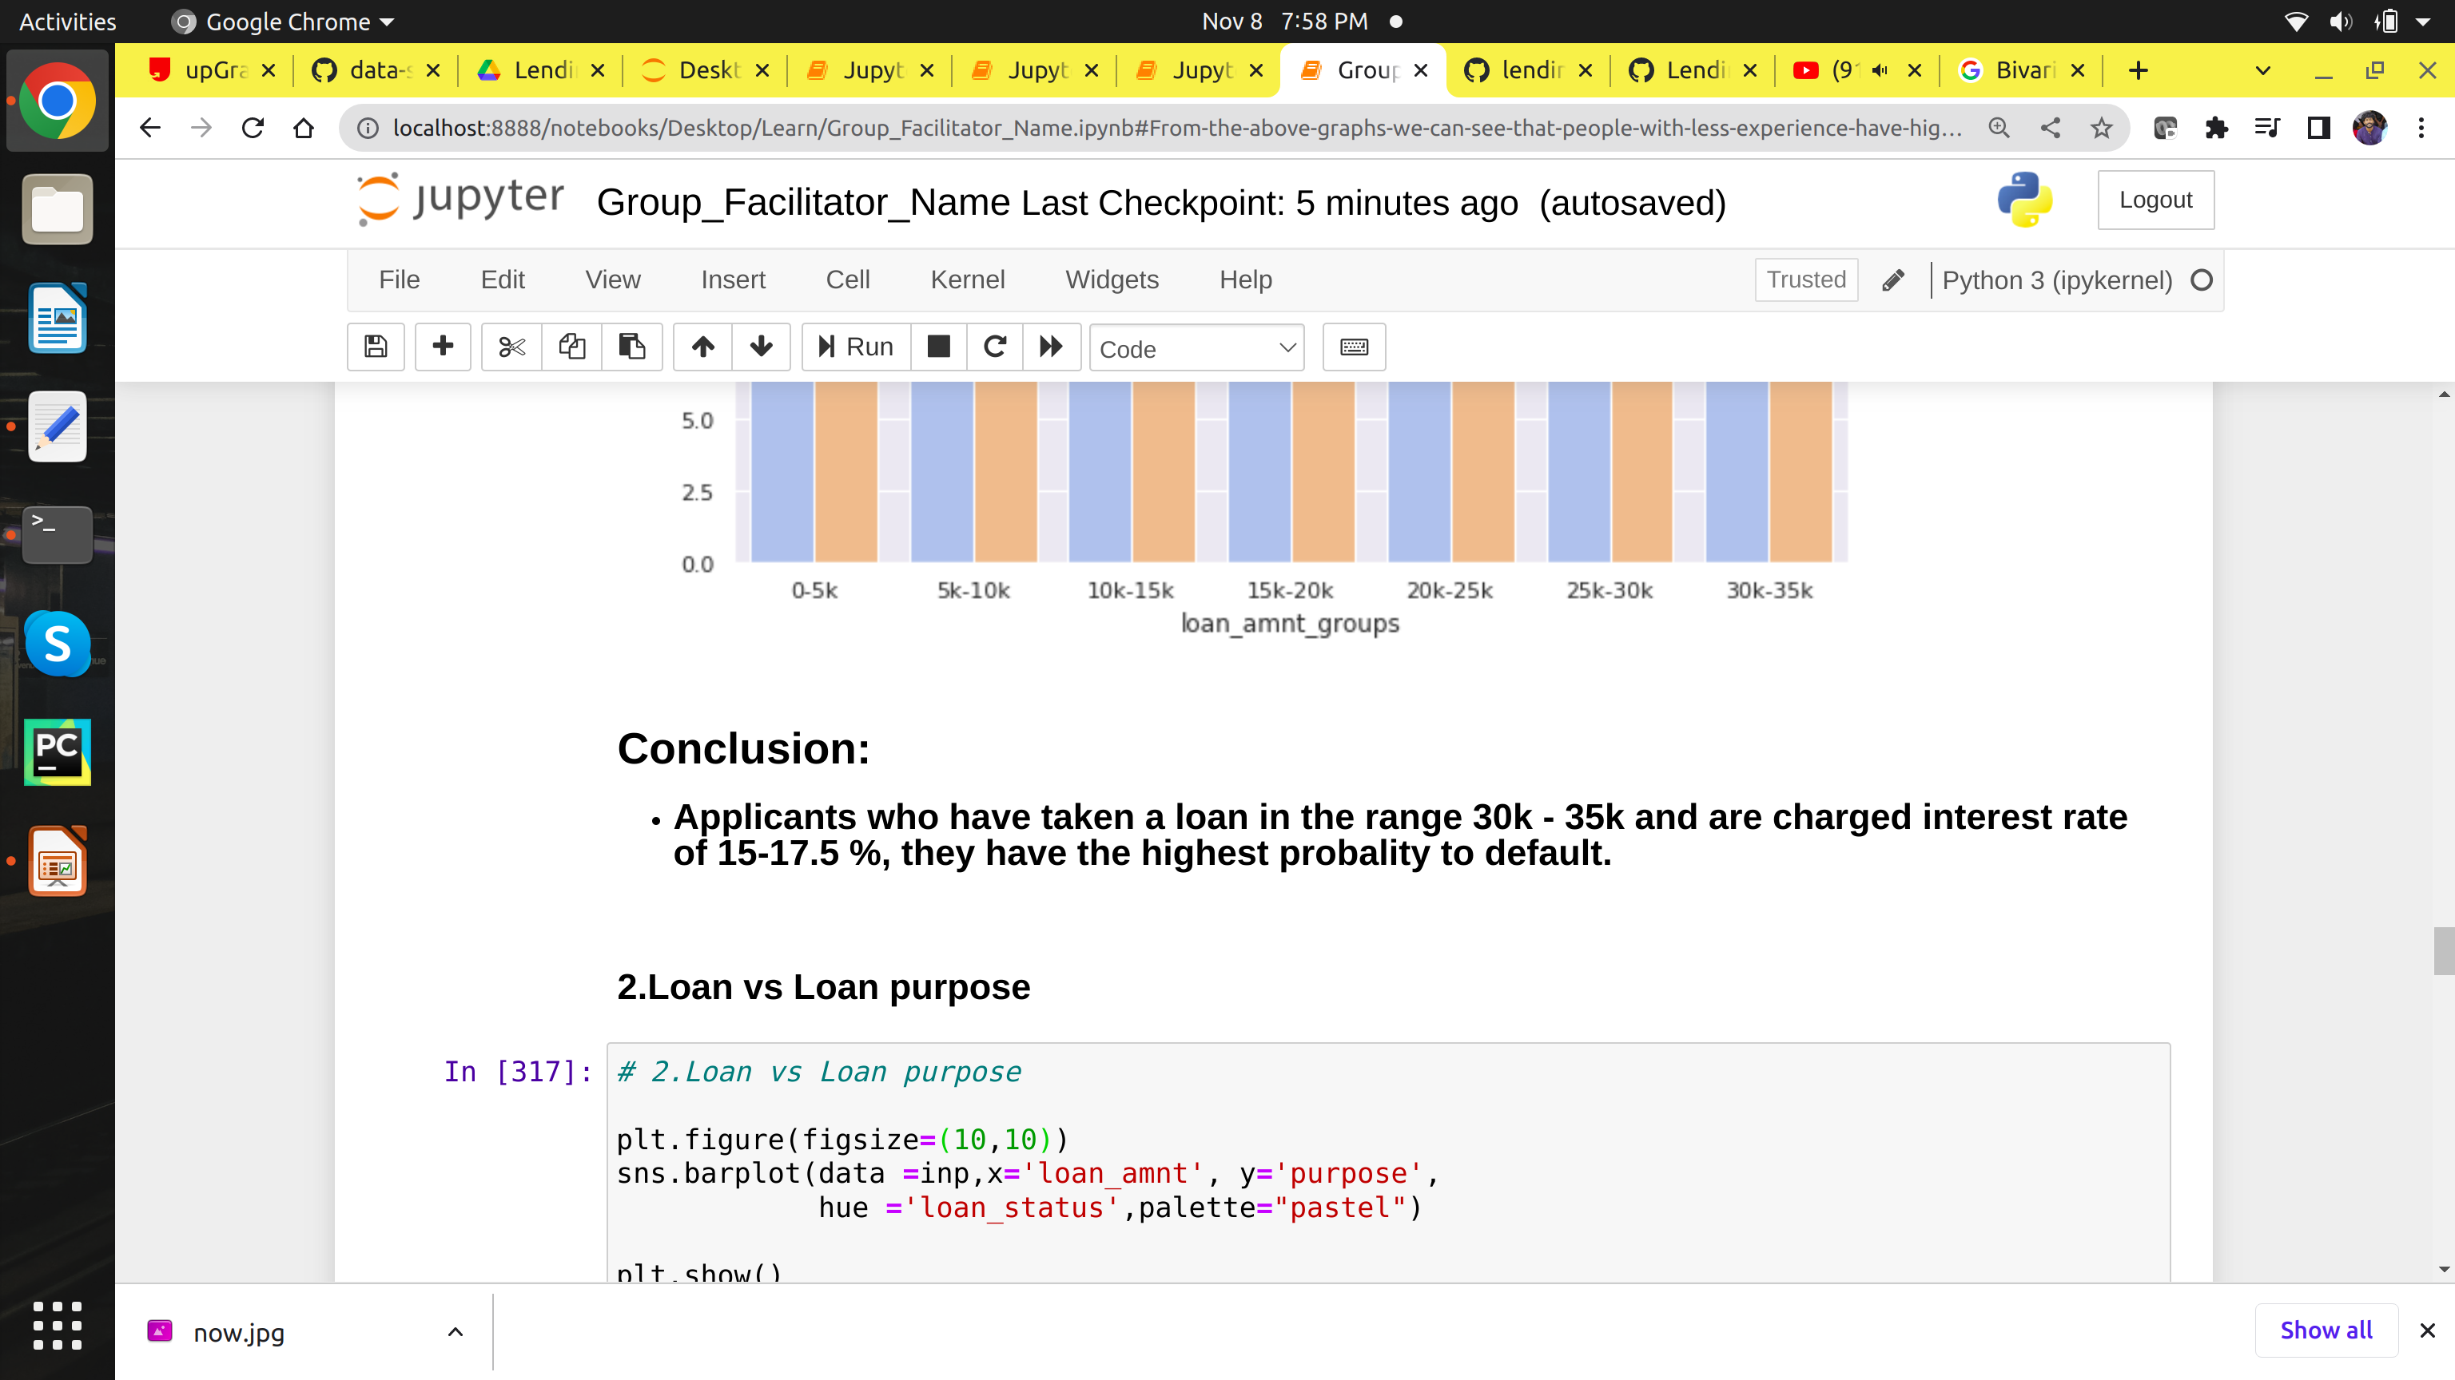

Slide 41
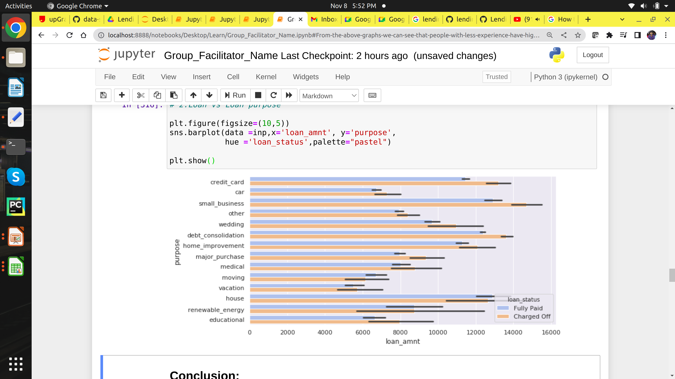
2.Loan vs Loan purpose

Slide 42
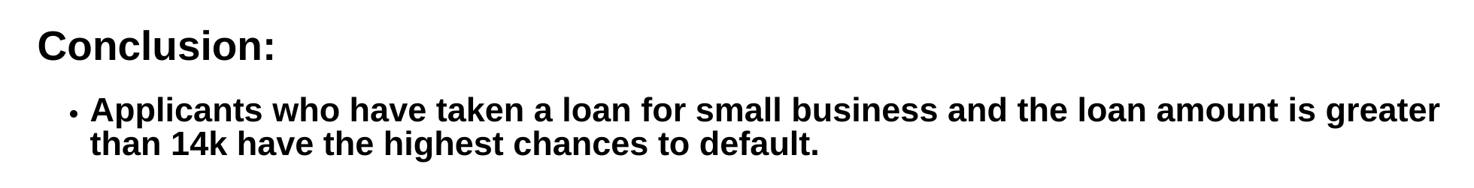

Slide 43
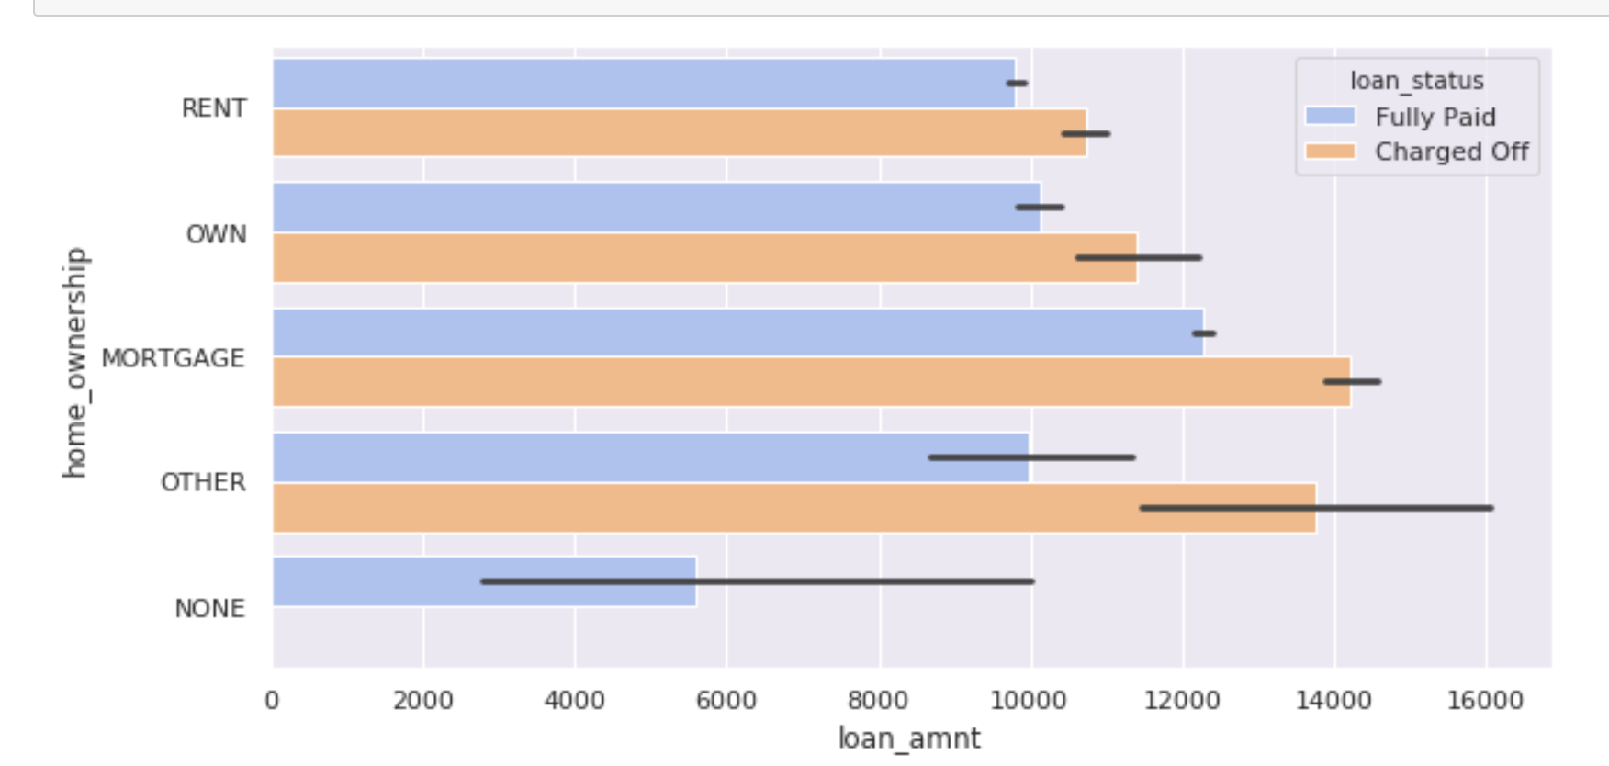
3.Loan vs House Ownership

Slide 44
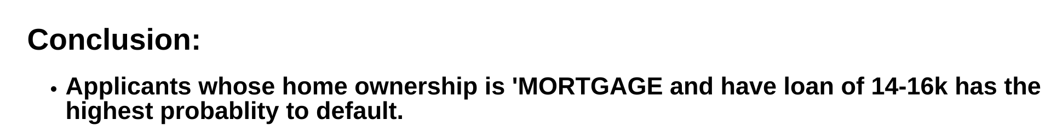

Slide 45
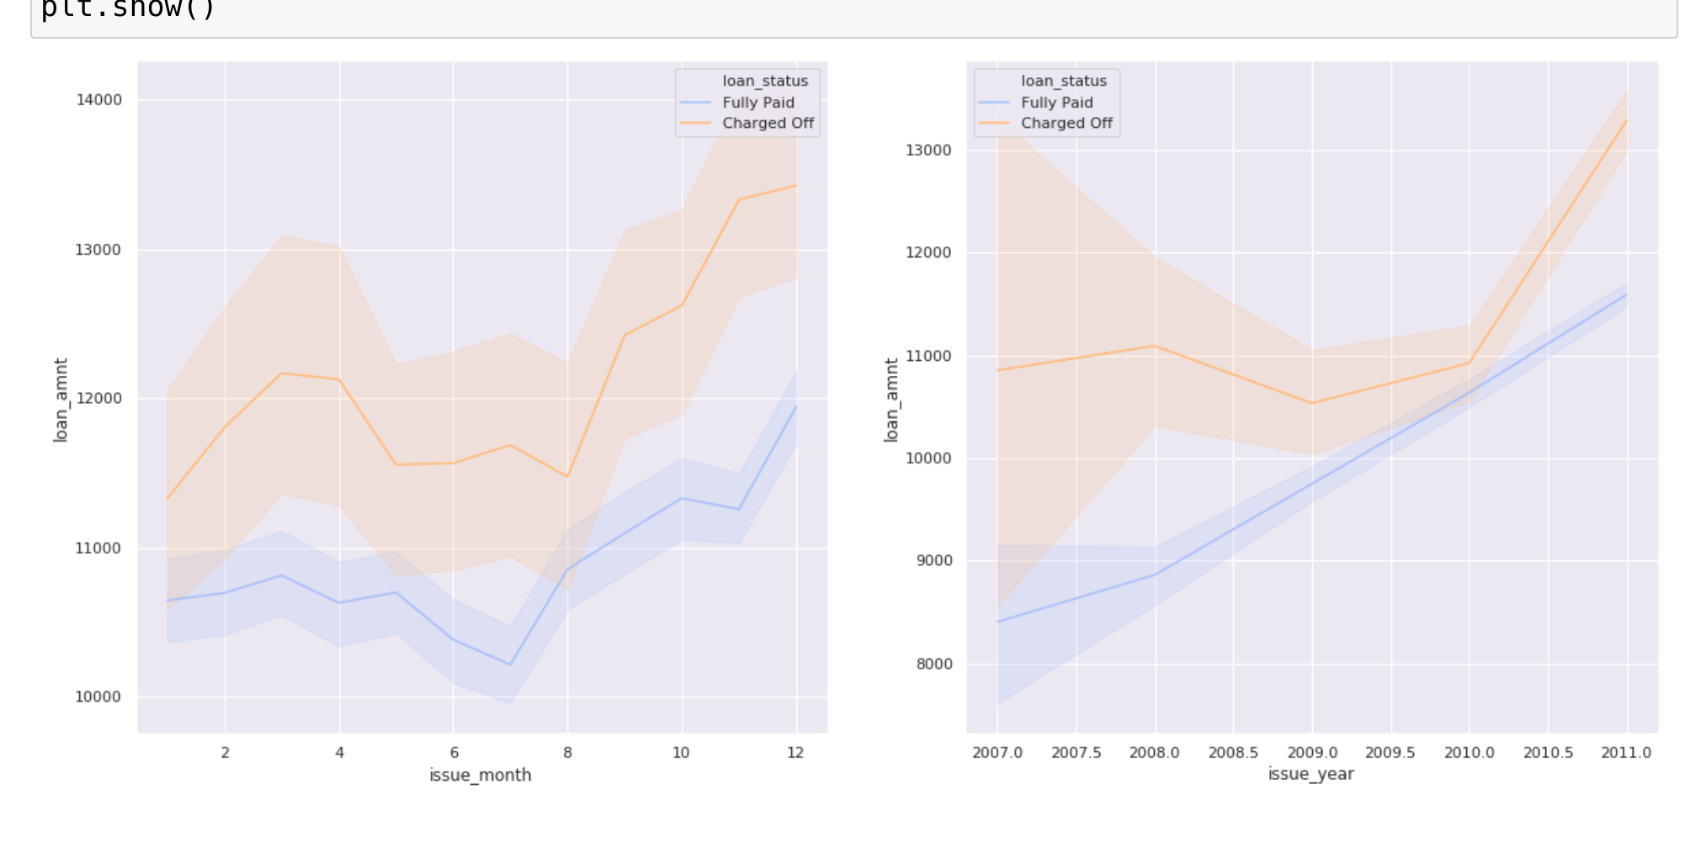
4.Loan amount vs month issued and year issued

Slide 46
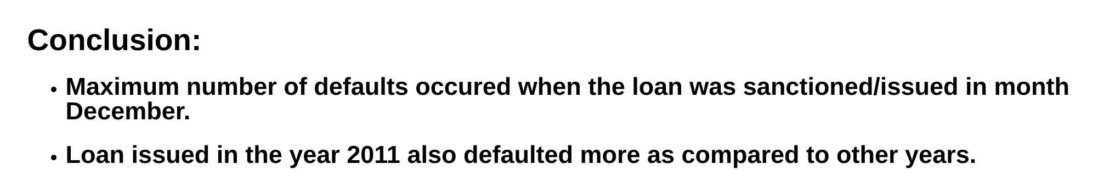

Slide 47
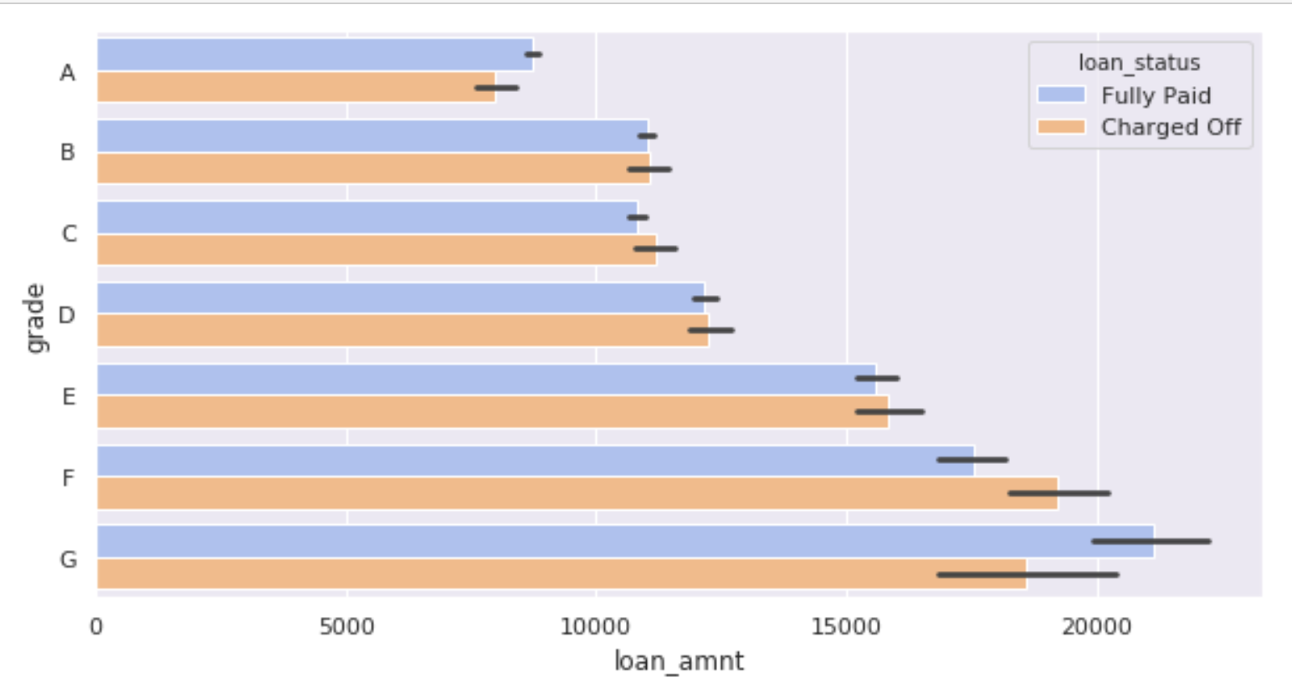
5.Loan amount vs Grade

Slide 48
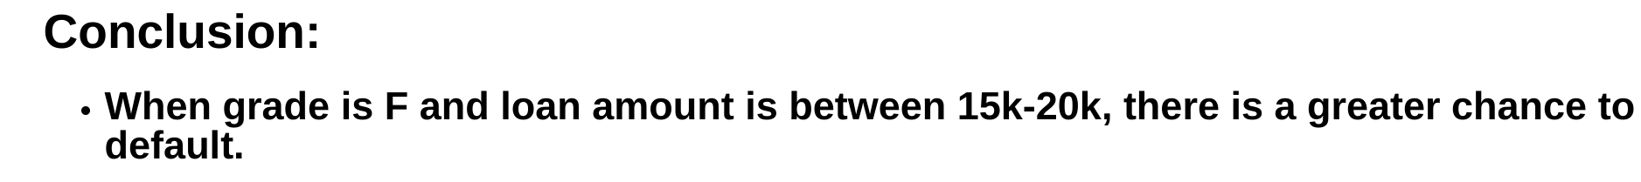

Slide 49
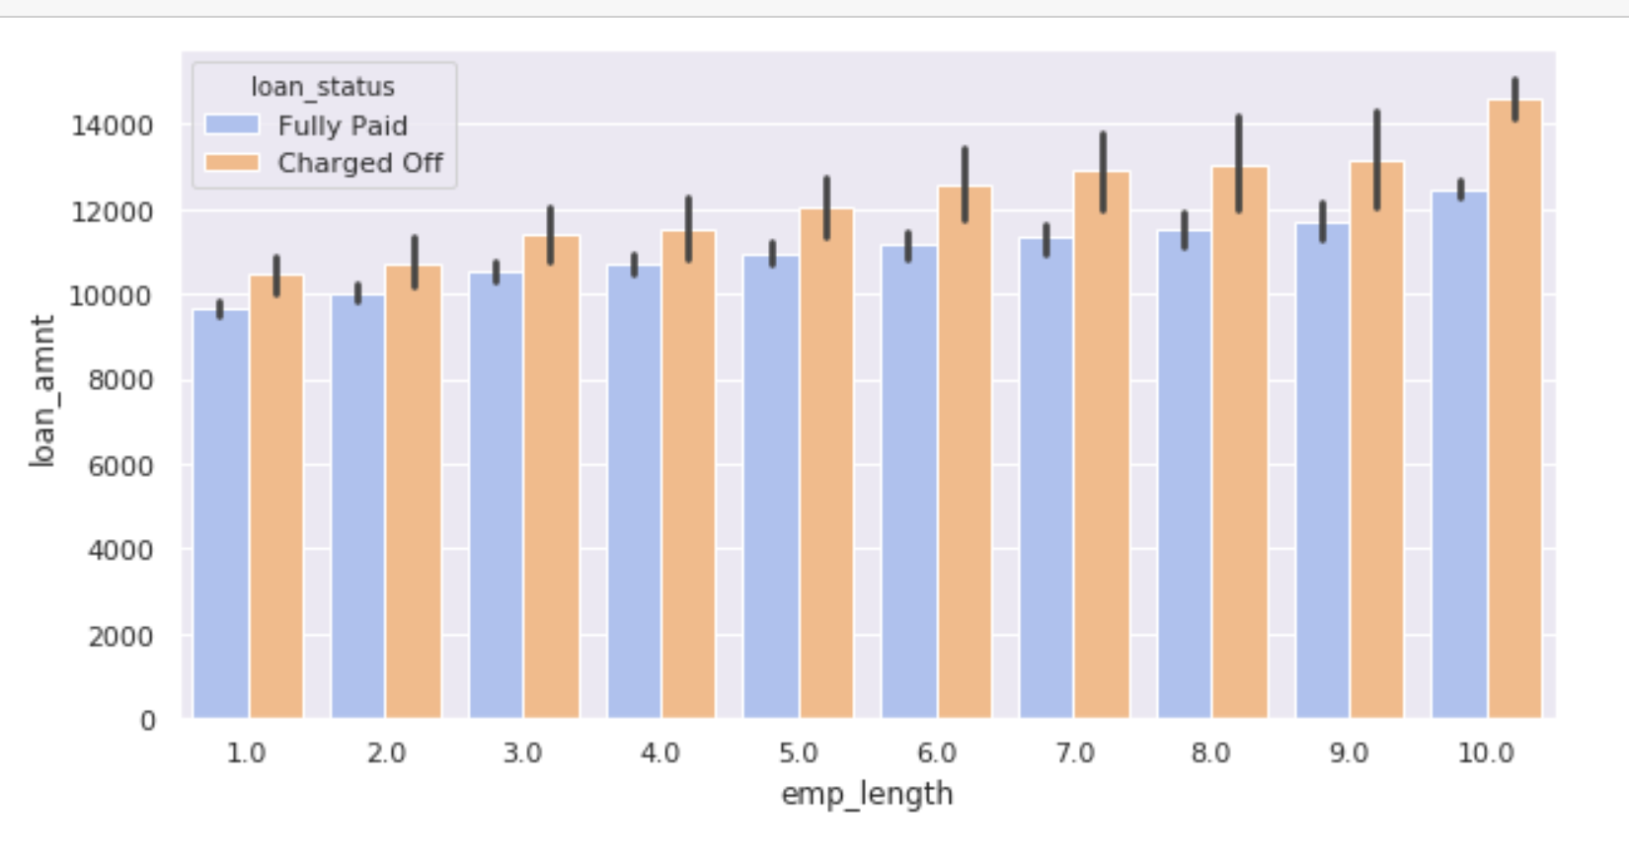
6.Loan amount vs employee length

Slide 50
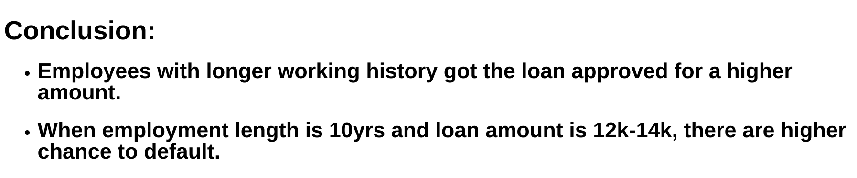

Slide 51
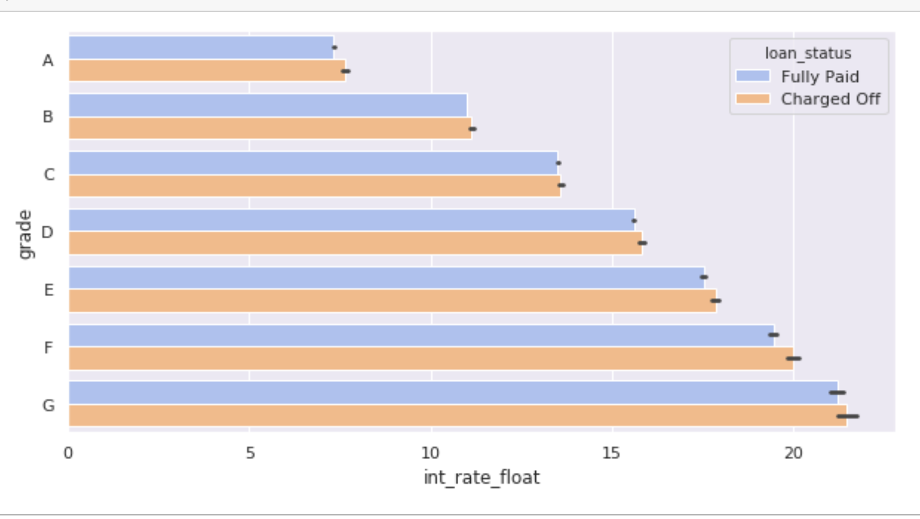
7.Grade vs interest rate

Slide 52
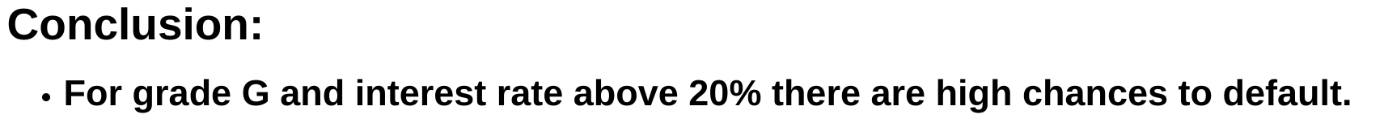

Slide 53
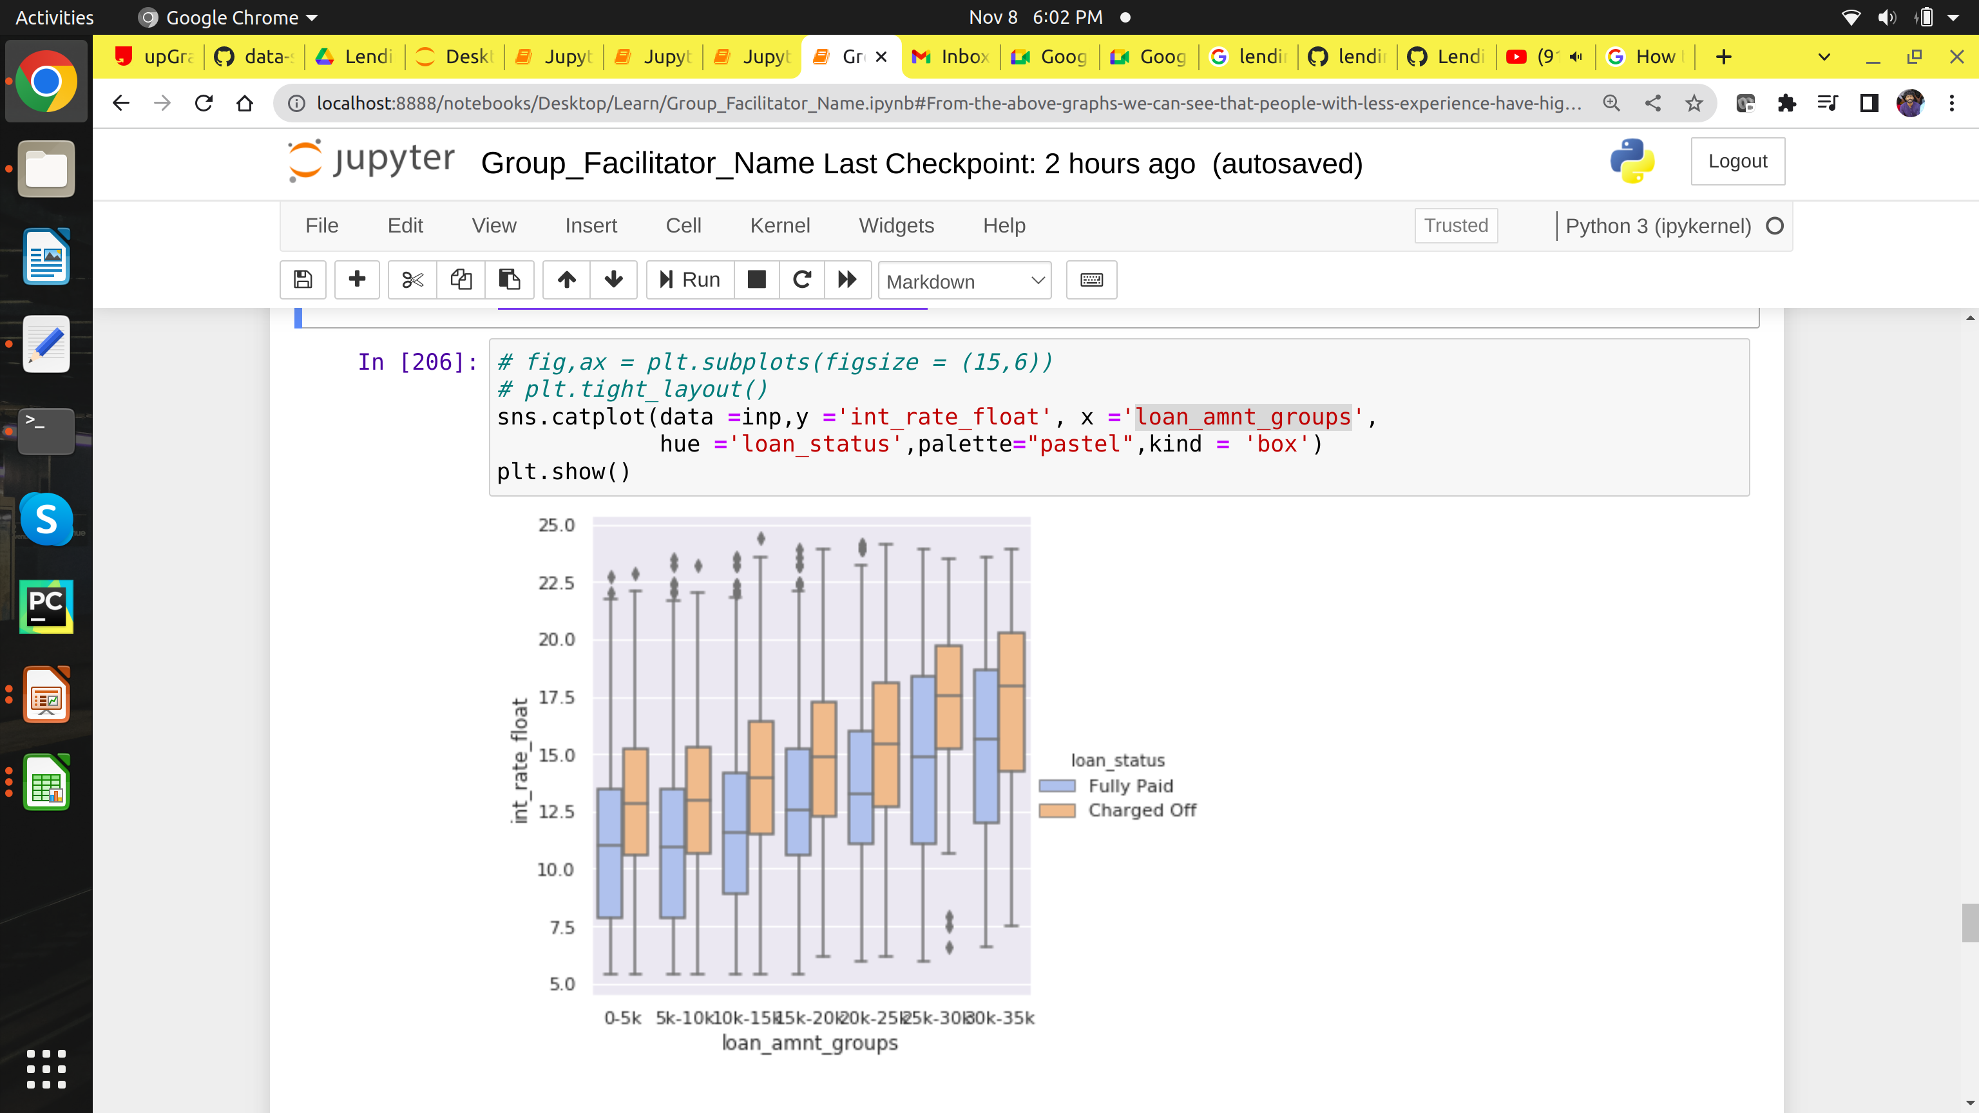
8.Interest rate and loan amount

Slide 54
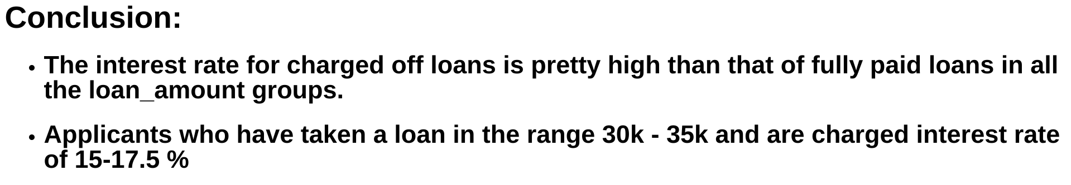

Slide 55
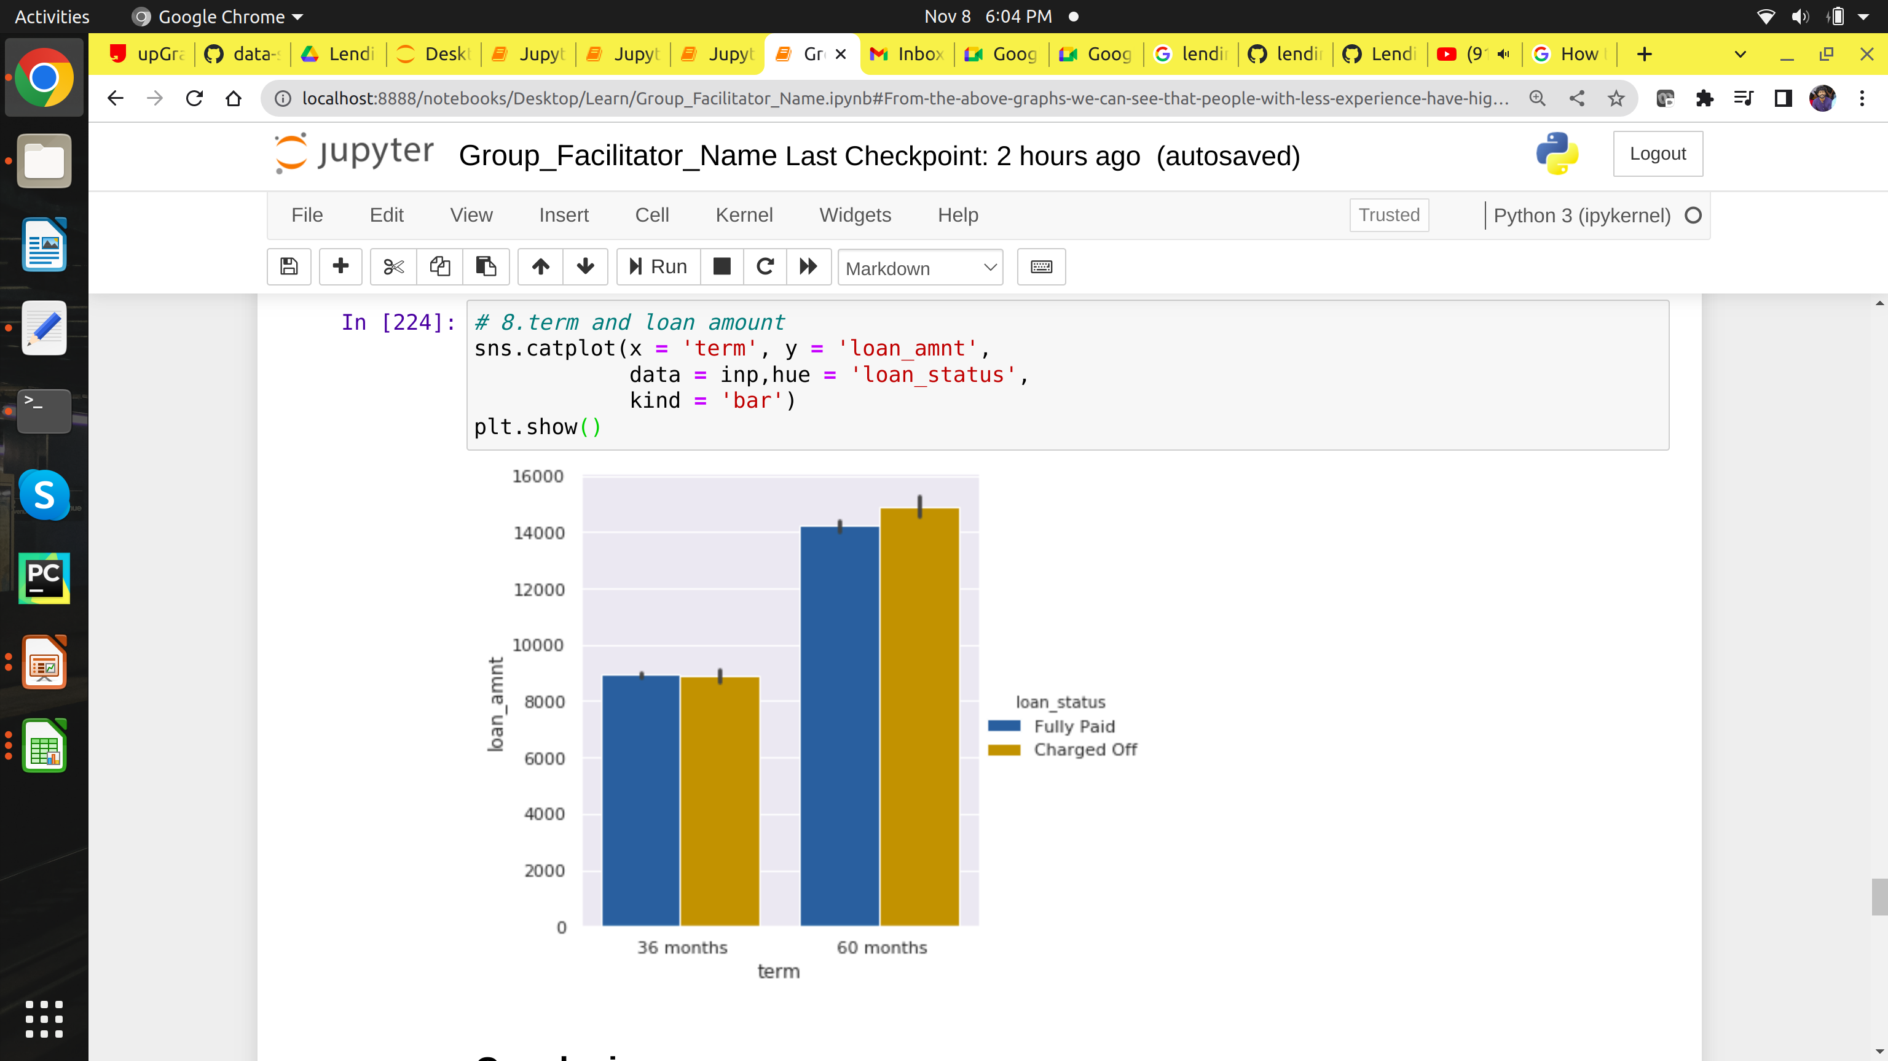
8.Term and loan amount

Slide 56


Slide 57

Analysing annual income with other columns for more insights

Slide 58

1.Annual income vs loan purpose

Slide 59


Slide 60

2.Annual income vs home ownership

Slide 61


Slide 62

3.Annual Income vs Loan amount

Slide 63


Slide 64

3. Annual income vs int_rate

Slide 65


Slide 66


Slide 67
It requires a very unusual mind to undertake the analysis of the obvious.
<number>

